Slide 1
Industry Review of Mobile Apps for Offline Navigation
PROGRAMING LANGUAGES: PYTHON, R
USED ANALYSIS:
Descriptive analysis
Sentiment analysis
ML
AUTHORS: NIKOLA GREB & FILIP SVIBEN
DATE: 25.08.2020.

Slide 2
Data overview
DATA GATHERING METHODOLOGY: Web scraping
TIMELINE: 15.06.2016 – 15.06.2020.
SAMPLE: 8 offline navigation apps
TOTAL NUMBER OF REVIEWS ON G-PLAY STORE: N=11.449.977
TOTAL NUMBER OF SCRAPED REVIEWS: N=188.420
TOTAL NUMBER OF ANALYZED REVIEWS: N=134.144
Smaller apps | Larger apps
Genius Maps TomTom CoPilot Navmii GPS World | Sygic Maps.me Waze Here

Slide 3
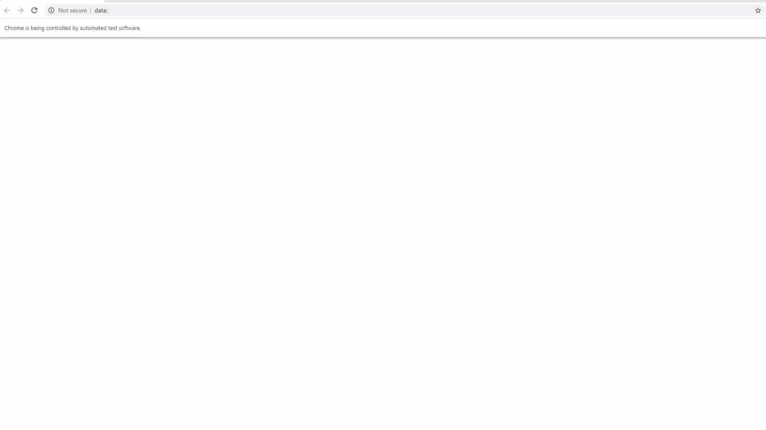

Slide 4
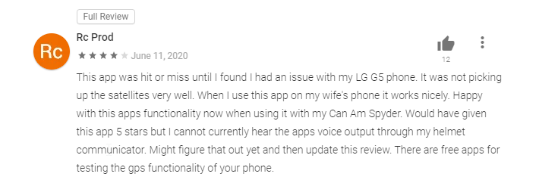
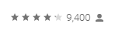
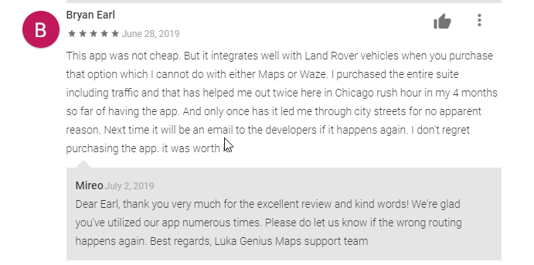
Google Play Store – What is What

Slide 5




Application | Number of reviews on G-Play Store (with or without comment) | Average rating of all reviews (with or without comment) – 03.08.2020. | Number of scraped reviews with comments outside of analyzed timeline | Number of scraped reviews used in this report (N) | Average number of reviews per day (with comments) | Average number of reviews per week (with comments) | Average number of reviews per month (with comments) | Average number of reviews per year (with comments)
Genius Maps | 9312 | 4.2 | 562 | 277 | 0.2 | 1.3 | 5.6 | 68.3
TomTom | 158240 | 4.0 | 12422 | 8145 | 5.7 | 38.8 | 166.2 | 1910.7
CoPilot | 100237 | 3.9 | 11067 | 4136 | 2.8 | 19.7 | 84.4 | 1064.7
Navmii GPS World | 113588 | 3.8 | 12748 | 1044 | 0.71 | 4.9 | 21.3 | 227.7
Notes:
Scraped reviews used in report exclude reviews outside of defined timeline and reviews on languages that are not written in English for sure (less than 5%)
Genius Maps application has significantly lower amount of reviews on GoooglePlay store compared to other smaller offline navigation apps (9312). Other smallers apps have more than 100k reviews on play store, arround 11-12k among those are reviews with comments.
TomTom has majority of his reviews posted in the past 4 years. CoPilot and Navmii review frequency is dropping.

Slide 6
 |  | Number of reviews used in this report per year
Application | N (with comments) | 2016 | 2017 | 2018 | 2019 | 2020
Genius Maps | 277 | 39 | 52 | 69 | 84 | 33
TomTom | 8145 | 1651 | 2064 | 1555 | 2113 | 762
CoPilot | 4136 | 507 | 1186 | 566 | 1442 | 435
Navmii GPS World | 1044 | 314 | 369 | 169 | 145 | 47
Notes:
Reference table. Number of reviews used to present data in future slides*

Slide 7
 |  | Number of reviews used in this report per month
Application | N (with comments) | Jan | Feb | Mar | Apr | May | Jun | Jul | Aug | Sep | Oct | Nov | Dec
Genius Maps | 277 | 28 | 17 | 20 | 22 | 26 | 27 | 23 | 27 | 18 | 21 | 21 | 27
TomTom | 8145 | 556 | 584 | 611 | 583 | 663 | 691 | 745 | 811 | 768 | 722 | 708 | 703
CoPilot | 4136 | 456 | 414 | 347 | 342 | 332 | 336 | 350 | 429 | 324 | 281 | 235 | 290
Navmii GPS World | 1044 | 68 | 53 | 58 | 48 | 68 | 118 | 137 | 147 | 103 | 108 | 69 | 67
Notes:
Reference table. Number of reviews used to present data in future slides*

Slide 8




Application | Number of reviews on G-Play Store (with or without comment) | Average rating of all reviews (with or without comment) – 03.08.2020. | Number of scraped reviews with comments outside of analyzed timeline | Number of scraped reviews used in this report (N) | Average number of reviews per day (with comments) | Average number of reviews per week (with comments) | Average number of reviews per month (with comments) | Average number of reviews per year (with comments)
Sygic | 1661320 | 4.6 | 40624 | 36140 | 24.7 | 172.1 | 737.5 | 8261.7
Maps.me | 1152336 | 4.6 | 39766 | 32449 | 22.2 | 154.5 | 662.2 | 8080.0
Waze | 7783657 | 4.3 | 30724 | 30386 | 47.3 | 326.7 | 1381.2 | 10128.7
Here | 471287 | 4.3 | 40507 | 21567 | 14.8 | 102.7 | 440.1 | 4766
Notes:
Among bigger apps, Waze has the most reviews on GooglePlay store (7+ million), followed by Sygic (1.6M) and Maps.me (1.1M), while Here is significantly smalles with 0.5M.

Slide 9
 |  | Number of reviews used in this report per year
Application | N (with comments) | 2016 | 2017 | 2018 | 2019 | 2020
Sygic | 36140 | 9020 | 9741 | 5928 | 9116 | 2335
Maps.me | 32449 | 6108 | 8950 | 6476 | 8814 | 2101
Waze | 30386 | 0 | 0 | 5410 | 18896 | 6080
Here | 21567 | 6453 | 8147 | 3195 | 2956 | 816
Notes:
Reference table. Number of reviews used to present data in future slides*

Slide 10
 |  | Number of reviews used in this report per month
Application | N (with comments) | Jan | Feb | Mar | Apr | May | Jun | Jul | Aug | Sep | Oct | Nov | Dec
Sygic | 36140 | 2357 | 2291 | 2378 | 2448 | 2347 | 3324 | 3977 | 4286 | 3425 | 3037 | 3404 | 2866
Maps.me | 32449 | 2430 | 2260 | 2910 | 2155 | 2204 | 2274 | 2892 | 2868 | 2914 | 3433 | 3036 | 3073
Waze | 30386 | 2327 | 2443 | 2512 | 2223 | 2587 | 2735 | 2004 | 1641 | 2545 | 3148 | 3355 | 2866
Here | 21567 | 1957 | 1460 | 1689 | 1625 | 1579 | 1987 | 2292 | 2232 | 2062 | 1801 | 1433 | 1450
Notes:
Reference table. Number of reviews used to present data in future slides*

Slide 11
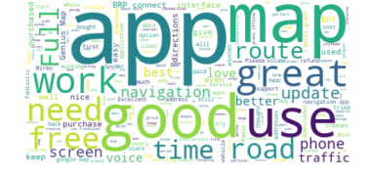
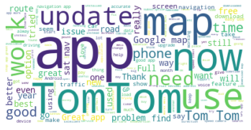
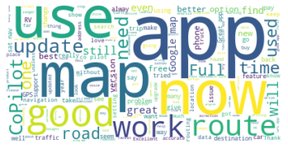
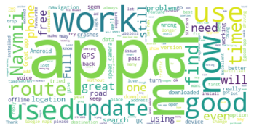
Word Clouds – Smaller Apps
Genius Maps
TomTom
CoPilot
Navmii
Notes:
***All future slides include data on reviews which include comments
We see words that are most often mentioned in each offline navigation app
To add on it, Tom Tom has strongest brand awarness and Genius Maps weakest according to word cloud method on given sample.
Most frequently used words in reviews in all three smaller apps are app, map and good.
They are followed by words like: work, now, use, update etc.
**TomTom word bubble is made of less words probably because it has higher number of reviews

Slide 12
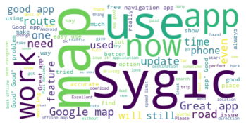
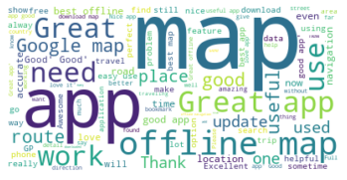
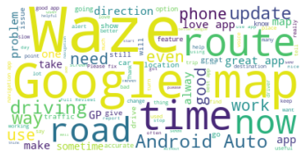
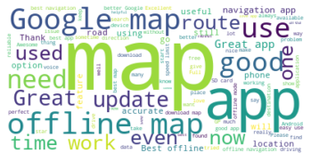
Word Clouds – Larger Apps
Sygic
Maps.me
Waze
Here

Slide 13
Comments – Stars Mean & SD by Year – Smaller Apps
Genius Maps (4.2)
TomTom (4.0)
CoPilot (3.9)
Navmii (3.8)
Notes:
Average rating of all smaller apps ranges from 2.5 to 4 with Genius Maps, TomTom and CoPilot having very simmilar average score (arround 3.5), while Navmii is below them (3.0). When we look at the changes in the trend, Genius Maps and TomTom have stable average rating in the past 5 years, while CoPilot and Navmii have slightly negative trend.
General conclusion, Genius Maps, Tom Tom,Navmii - people that write comments tend to leave more negative review (stars) – comparing to all users who rated the app
Data for CoPilot is not so clear
All 4 are in negative trend stagnation, Mireo especially. But when we take in account average mark of the app and previous conclusion - situation isn’t so bad.
Mireo 4.2
TomTom 4.0
CoPilot 3.9
Navmii 3.8

Slide 14
Comments – Stars Mean & SD by Year – Larger Apps
Sygic (4.6)
Maps.me (4.6)
Waze (4.3)
Here (4.3)
Notes:
Compared to the smaller apps, bigger apps have significantly higher average star rating which ranges from 3.5 to 4.5.
Sygic, Mapsm.me and Here have significantly higher average rating (4.0-4.5) compared to Waze (3.5).
Average rating is relatively stable for all aps, except for Here which has experienced slightly lower average star rating from 2018 to 2020
Waze - people that leave comments leave significanlty more negative final review (stars). – comparing to all users who rated the app
Sygic, Maps.me - slightly
All apps reviews except Waze are in stagnation or down trend.
Sygic 4.6
Maps.me 4,6
Waze 4.3
Here 4.3

Slide 15
Polarity Mean & SD by Year – Smaller Apps
Genius Maps
TomTom
CoPilot
Navmii
Notes:
Polarity is measure which calculates share of positive and negative emotions present in the sample text. It ranges from -1 (negative) to +1 (positive).
Polarity of all smaller apps is very simillar and it is on the positive side (ranging from 0.35 to 0.45) and it is also stable in the last 5 years.
**Note that standard deviation is also very high compared to the measured polarity, which means that polarity can vary a lot from the mean (having a lot of -1 and +1 reviews).
Give the definition of Polarity, tell how it’s made, explain subjectivity as well → we used Textblob analysis
On the first look, we see that there are both, people that are giving positive, and people that are giving negative review.
https://stackoverflow.com/questions/34518570/how-are-sentiment-analysis-computed-in-blob
The TextBlob NaiveBayesAnalyzer is apparently based on the Stanford NLTK. The Naive Bayes algorithm in general is explained here: A simple explanation of Naive Bayes Classification
and its application to sentiment and objectivity is described here: http://nlp.stanford.edu/courses/cs224n/2009/fp/24.pdf
Basically you're right that certain words will be labeled something like "40% positive / 60% negative" based on how they were used in some body of training data (for the Stanford NLTK, the training data was movie reviews). Then the scores of all words in your sentence get multiplied to produce the sentence score.
I haven't tested, but I expect that if the library returns exactly 0.0, then your sentence didn't contain any words that had a polarity in the NLTK training set. I suspect the researchers didn't include them because 1) they were too rare in the training data or
2) they were known to be meaningless (such as "the", "a", "and", etc.).
That goes for the Naive Bayes analyzer. Regarding the PatternAnalyzer, the TextBlob docs say it's based on the "pattern" library, but it doesn't seem to document how it works. I suspect something similar is happening though.
Std of polarity is more or less equal among all analyzed apps. Trends are stable.
But Mean of Polarity is going down for all 4 on graph - results are compatibile with results from previous variable - stars.

Slide 16
Polarity Mean & SD by Year – Larger Apps
Sygic
Maps.me
Waze
Here
Notes:
Polarity among bigger apps is no different than the previously shown data of polarity among smaller aps. It also has stable trend of average scores ranging from 0.35 to 0.45.
**Note that standard deviation is also very high compared to the measured polarity, which means that polarity can vary a lot from the mean (having a lot of -1 and +1 reviews).
All big apps are following starts data trend in polarity, hence waze polarity is growing, while Sygic and especially Here are in decreasing trend.

Slide 17
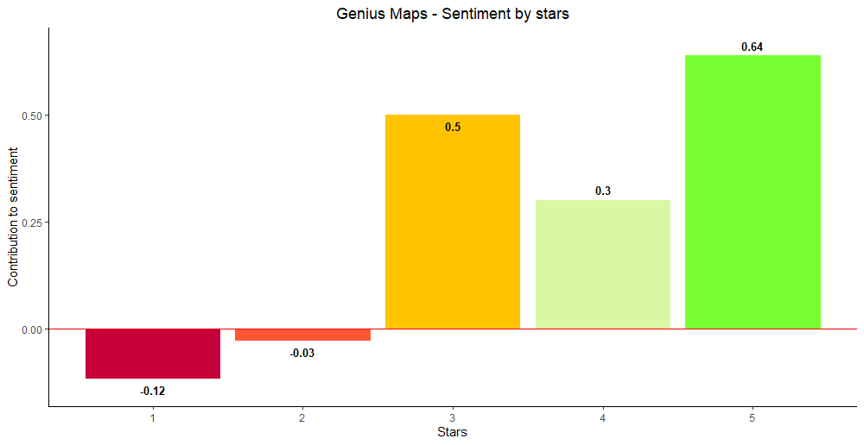
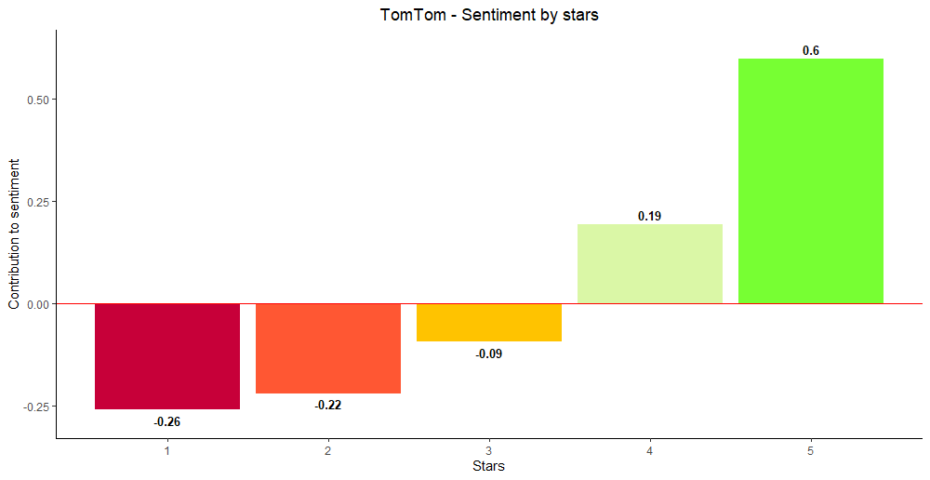
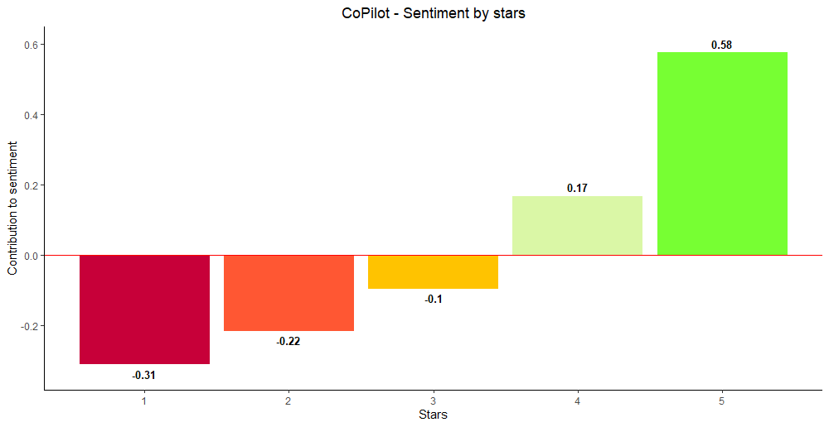
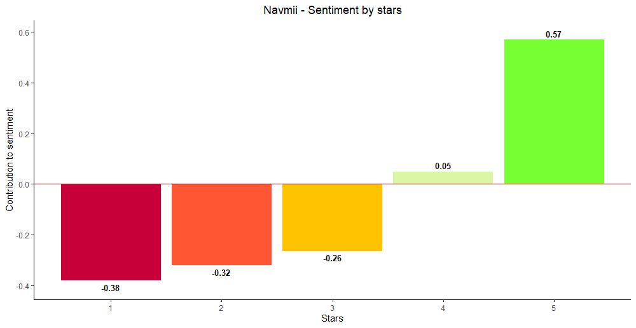
Sentiment by Stars – Smaller Apps
Notes:
As expected, sentiment increases with a higher rating.
All are logical except Genius Maps - ok, because of small sample in that app.

Slide 18
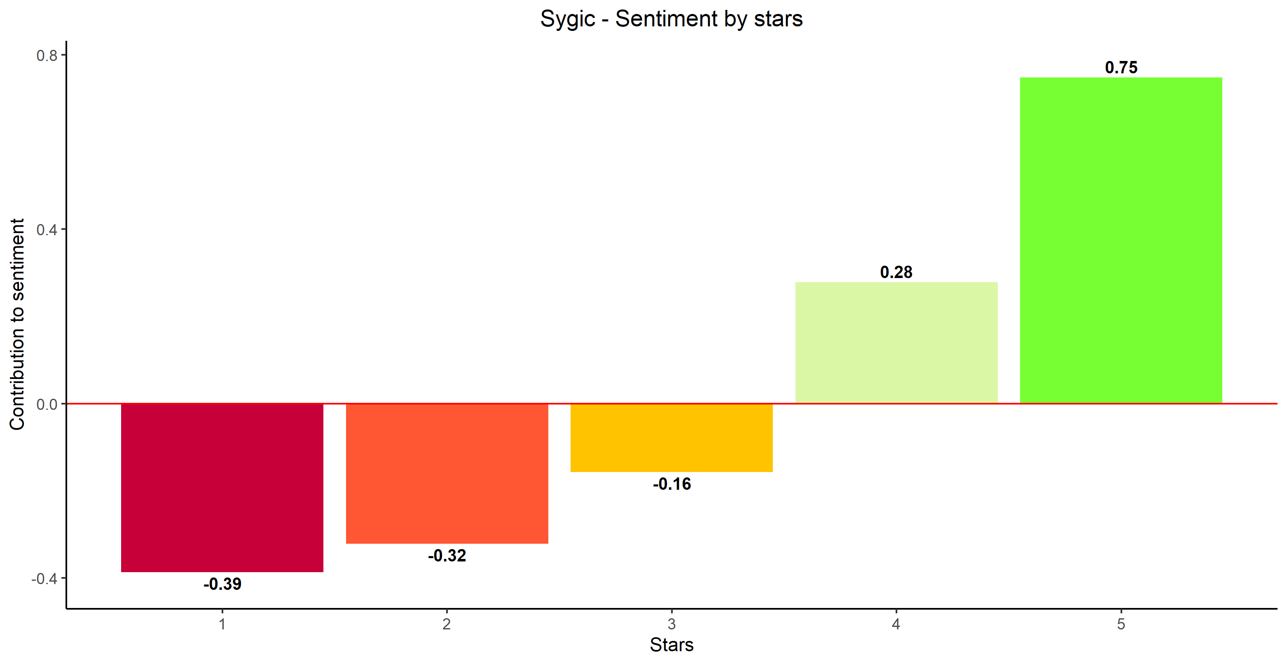
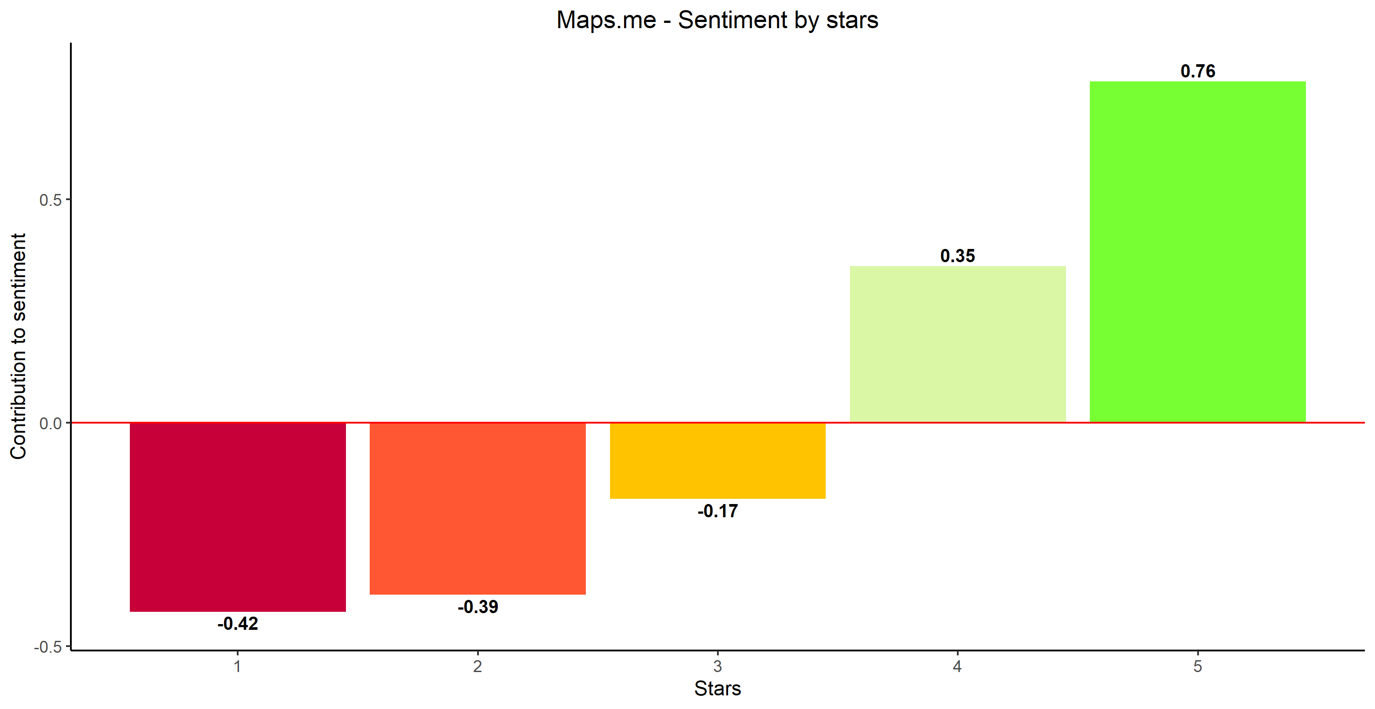
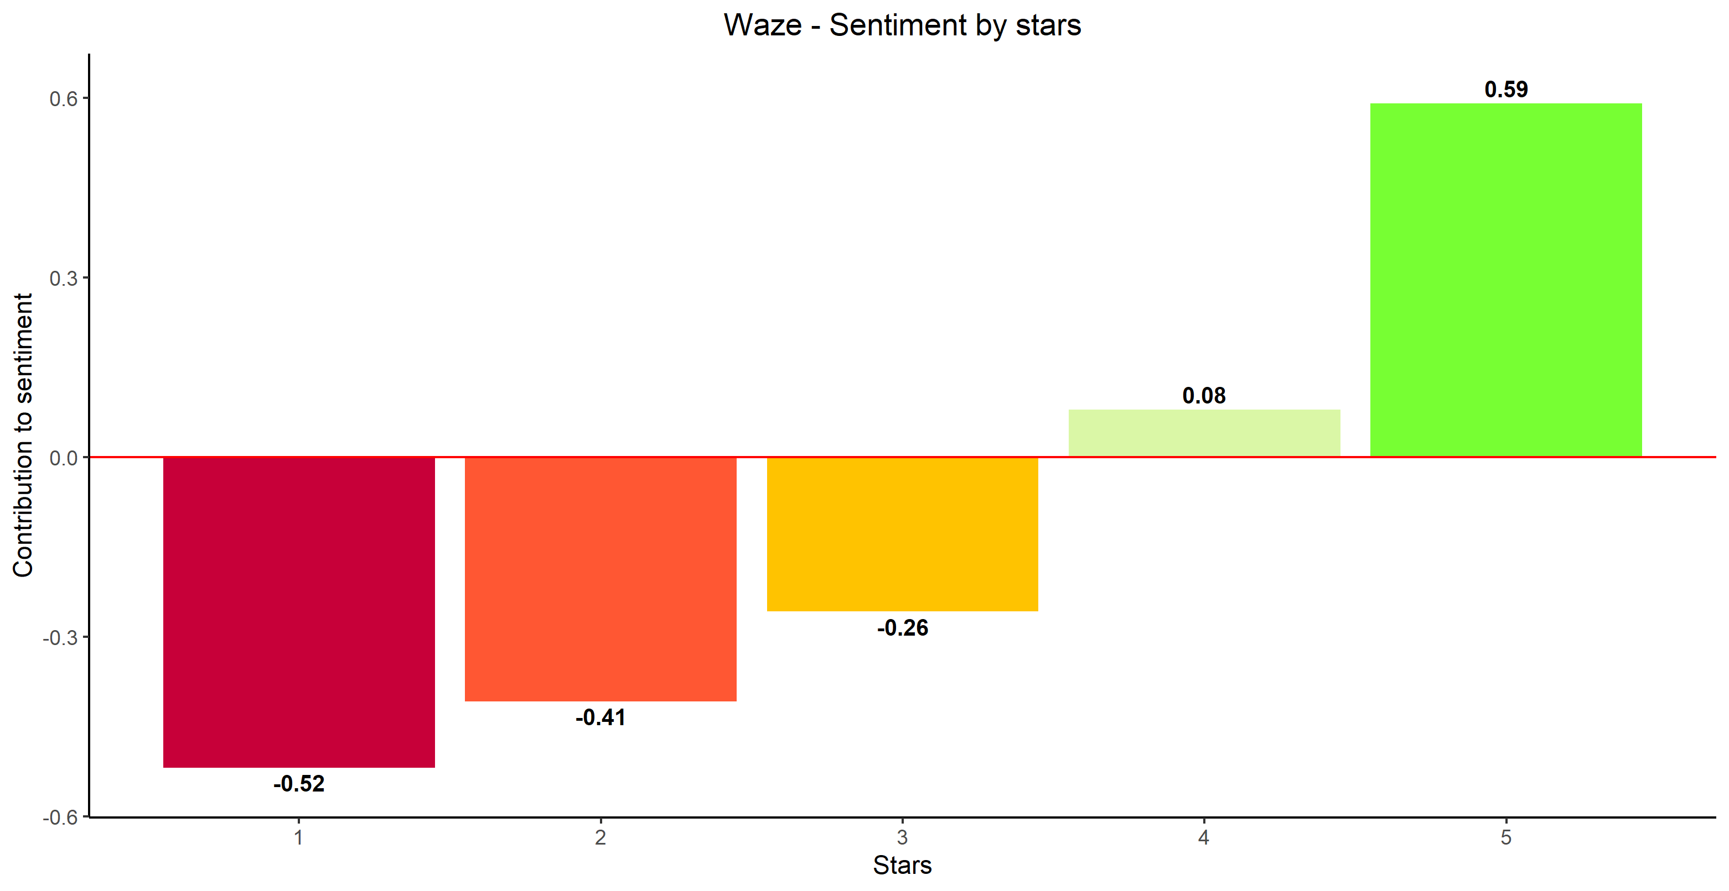
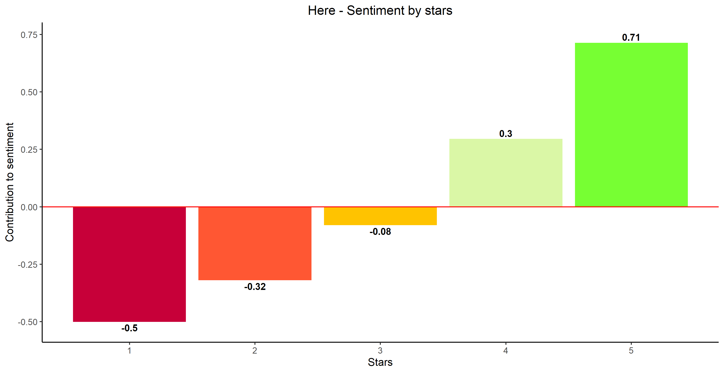
Sentiment by Stars – Larger Apps
Notes:
Similar conclusion for bigger apps, where 3 star reviews also have a negative sentiment rating.
Average sentiment score for Waze 5 star reviews is slightly lower compared to other bigger apps.

Slide 19
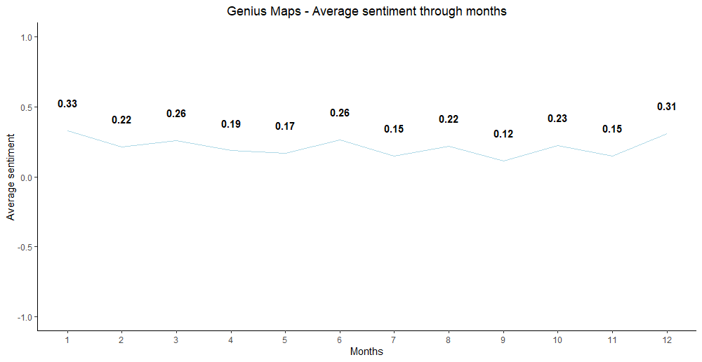
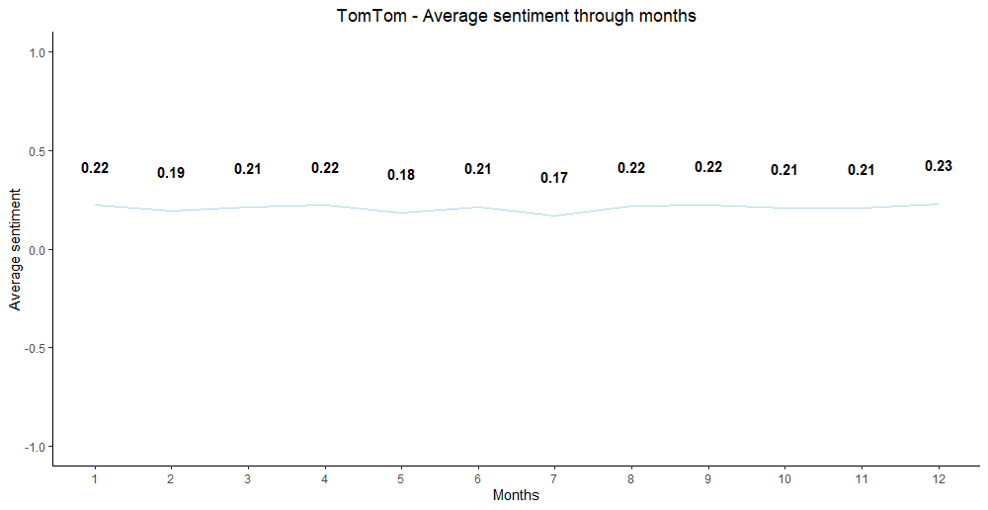
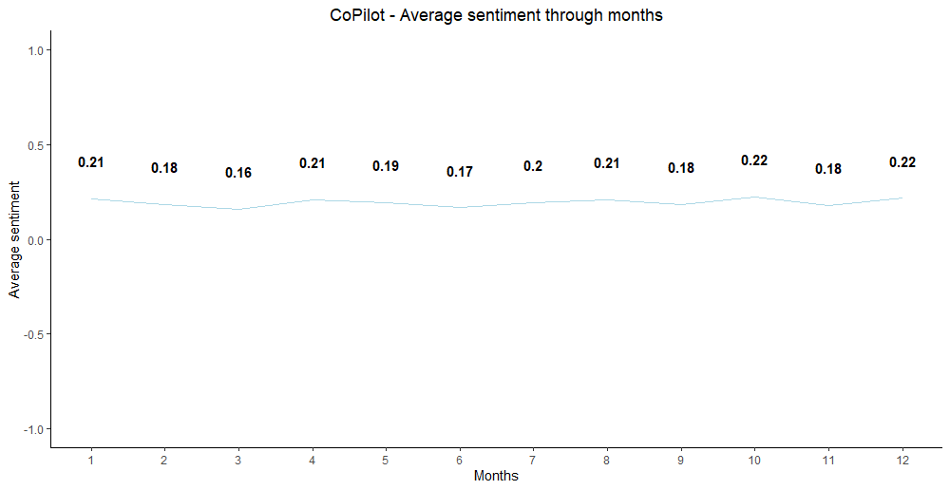
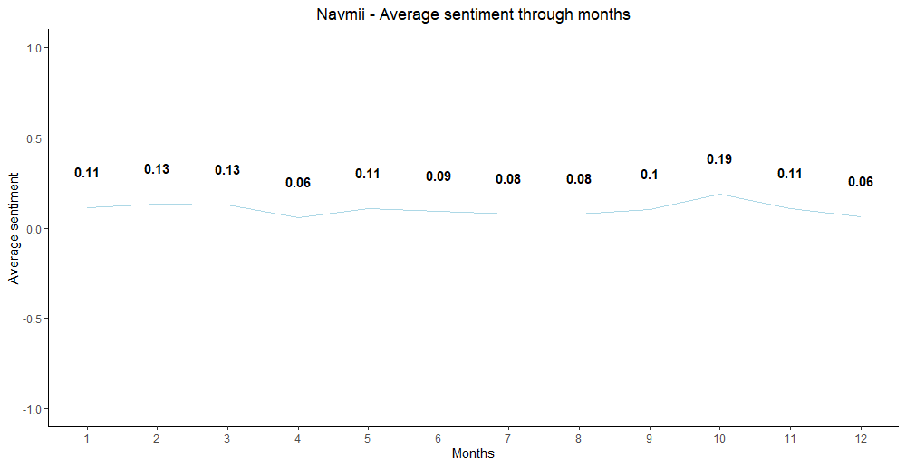
Sentiment Analysis – Smaller Apps (Seasonal)
Notes:
Sentiment is stable throughout the year for all 4 apps.
No big differences.
Similar results are found in seasonalities yearly dana in average star rating

Slide 20
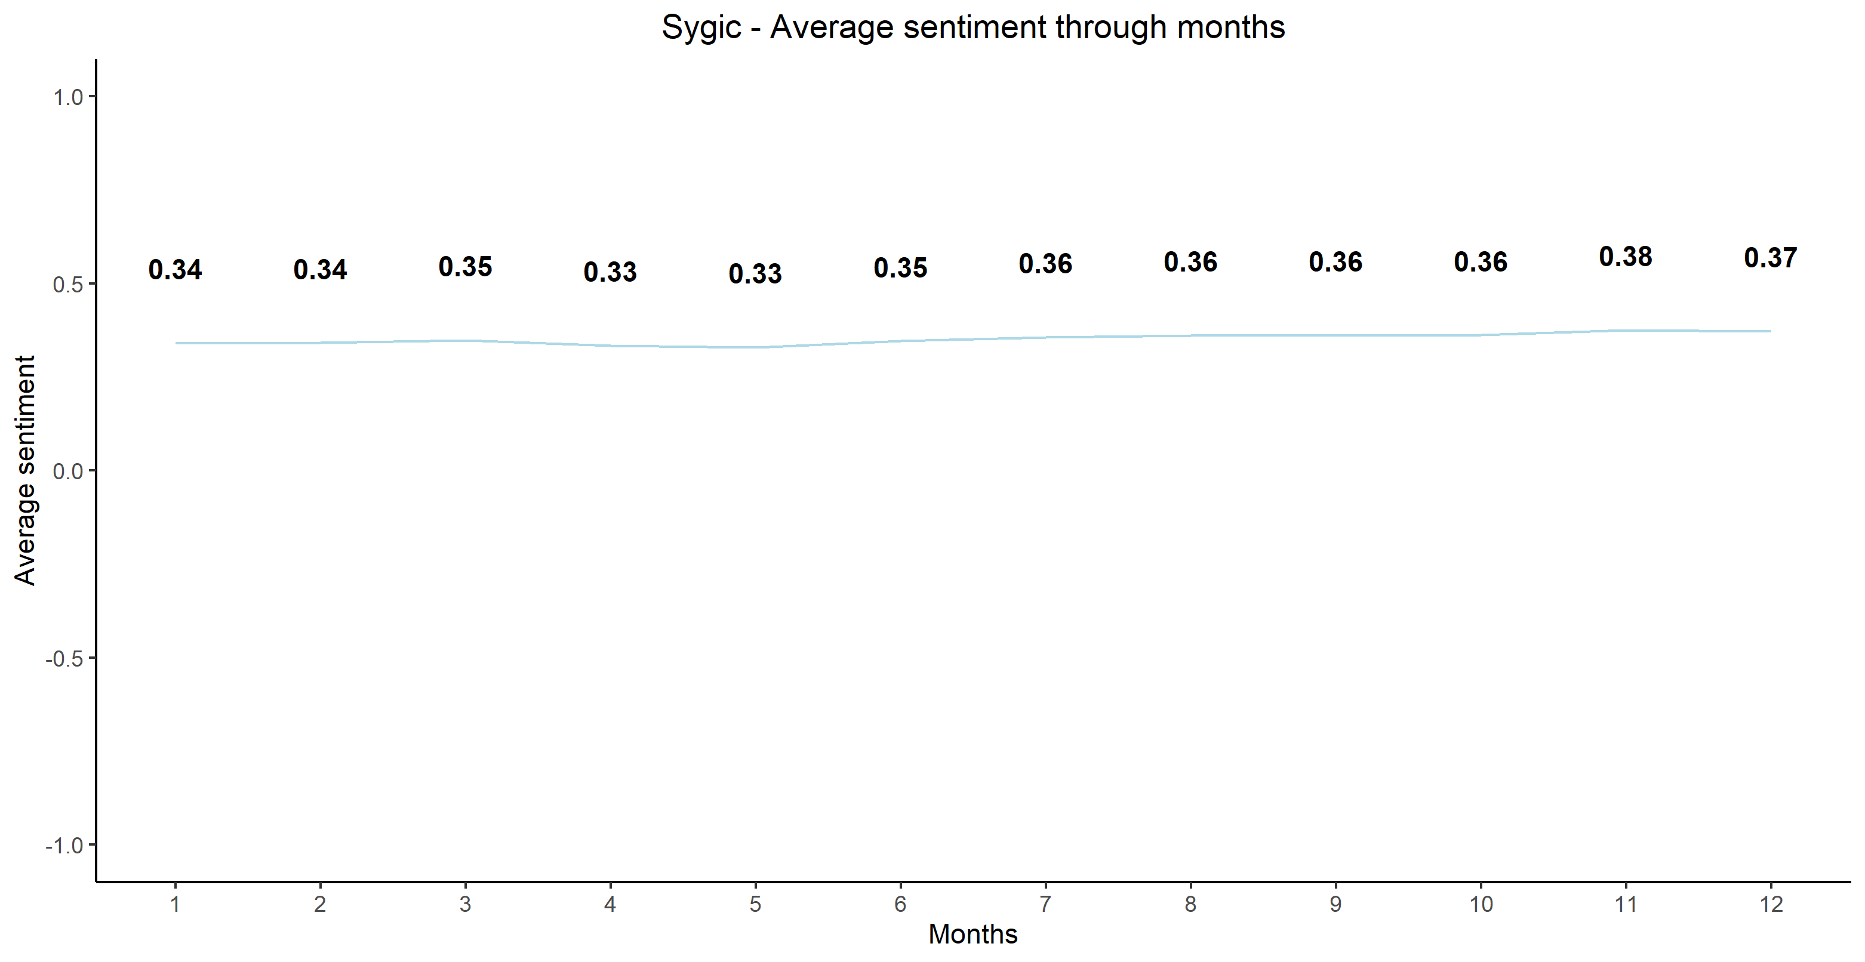
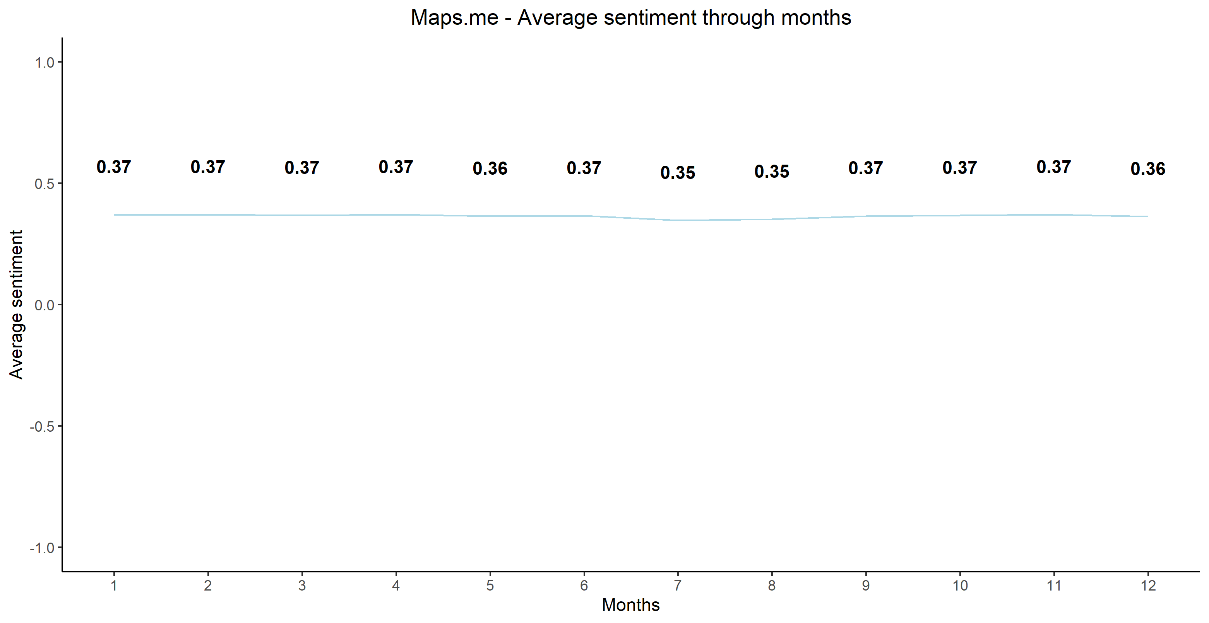
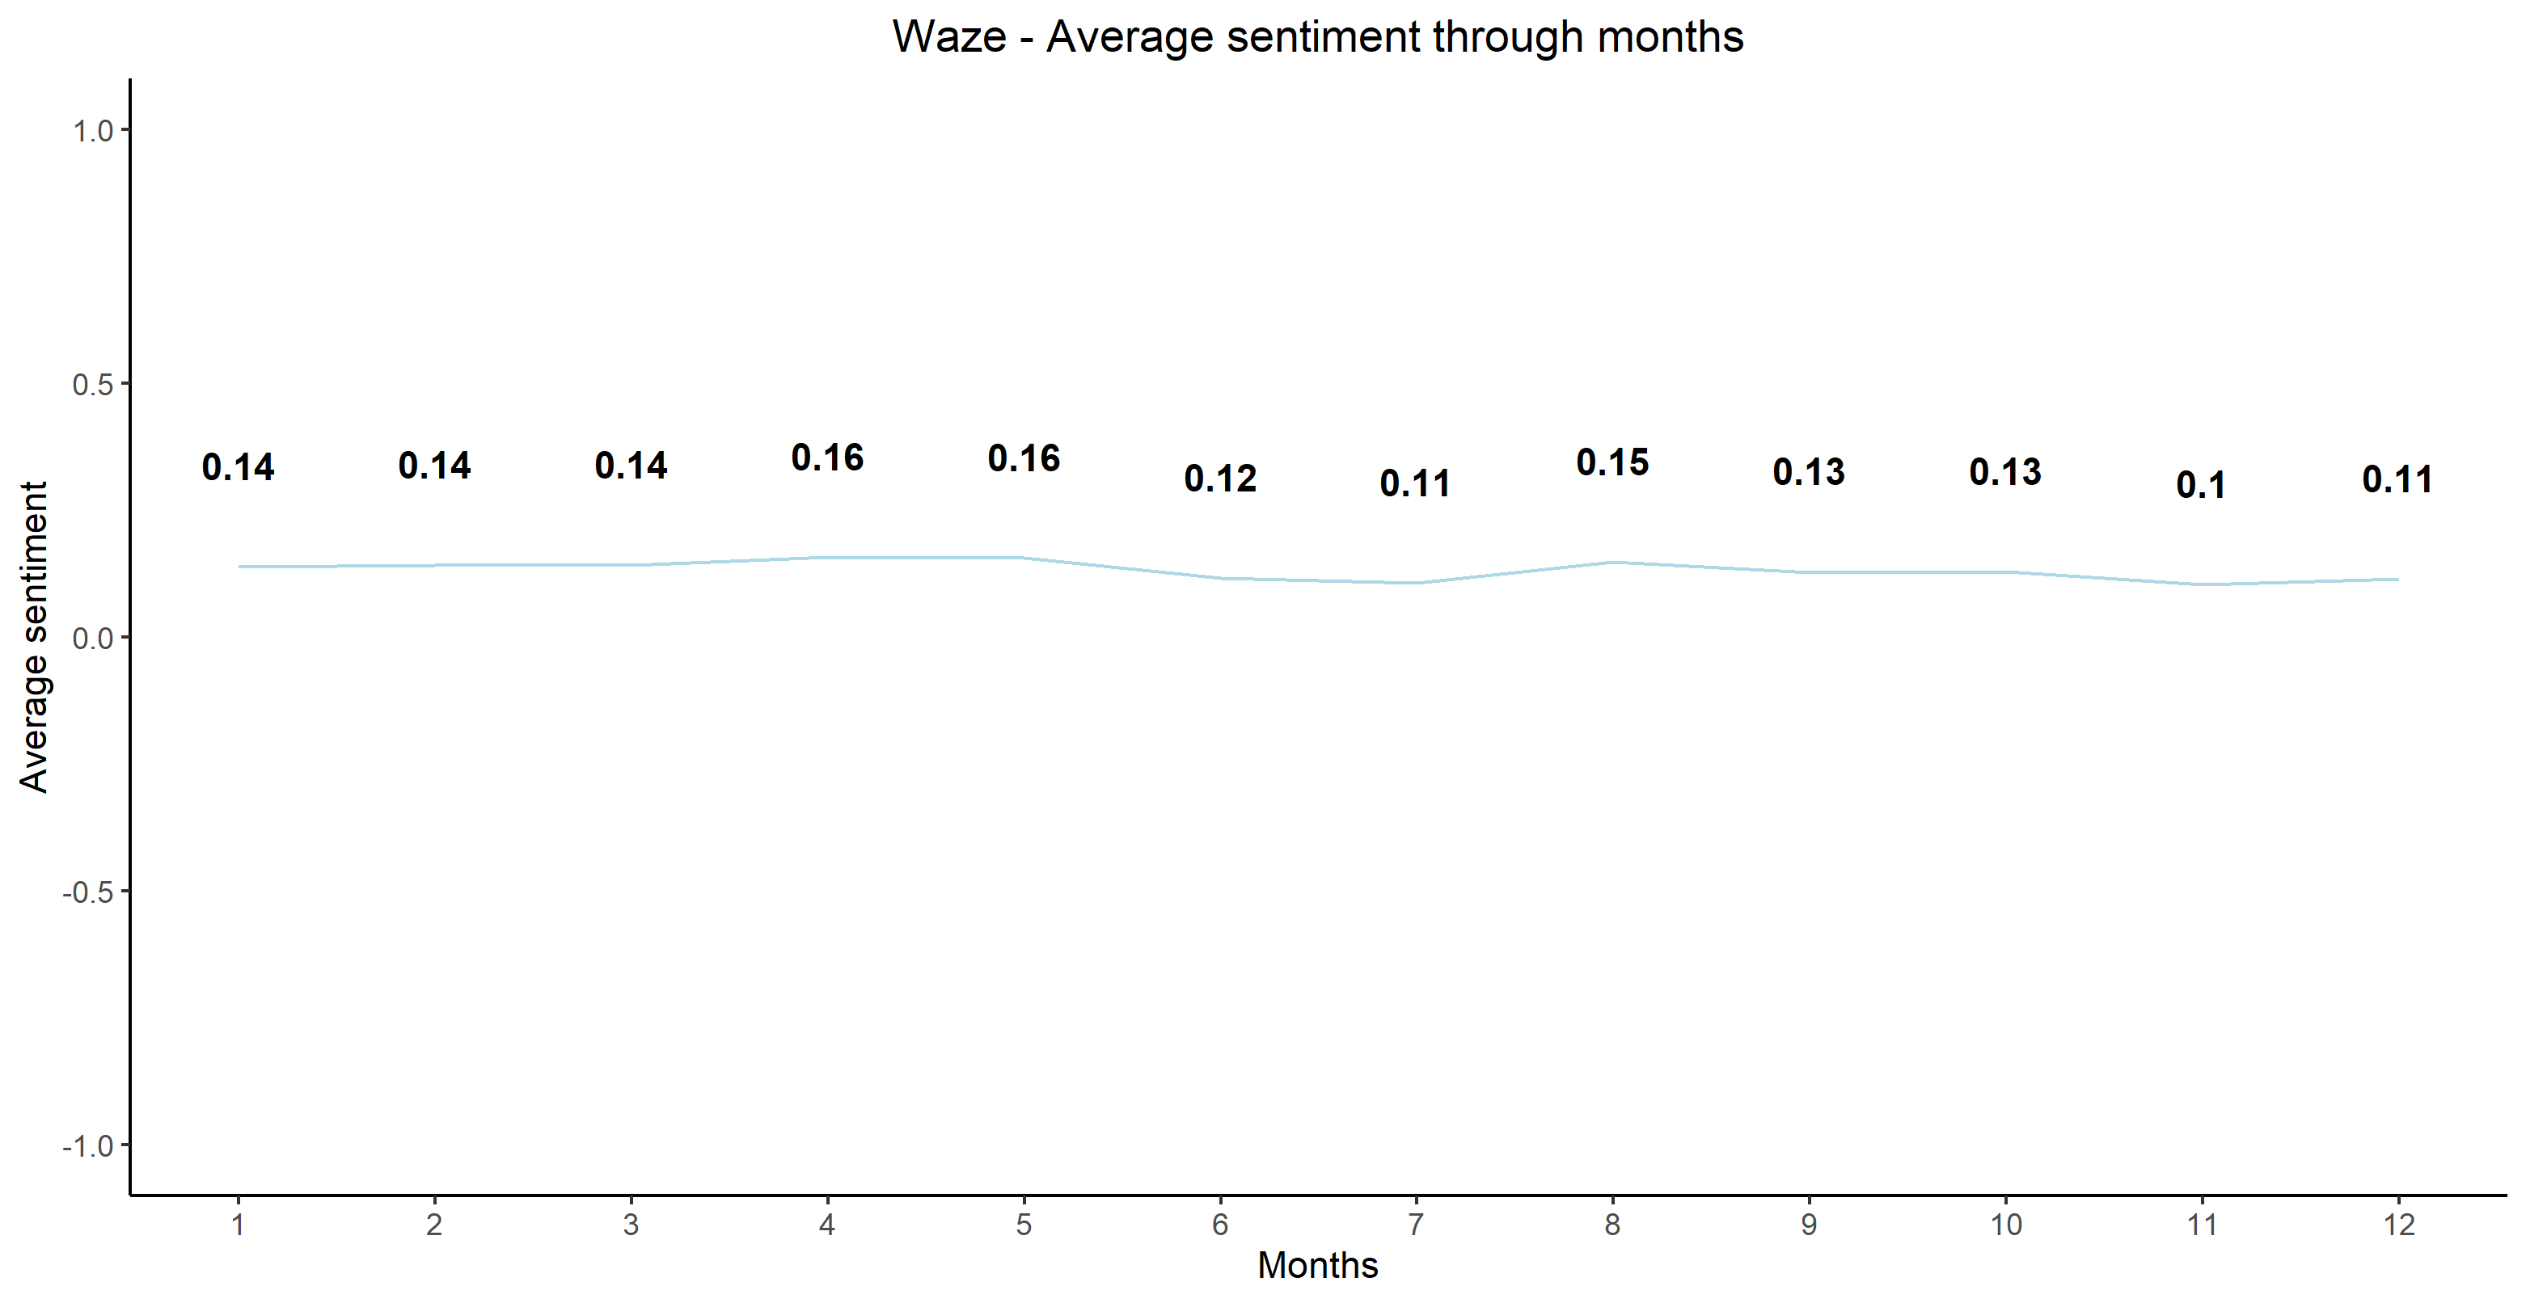
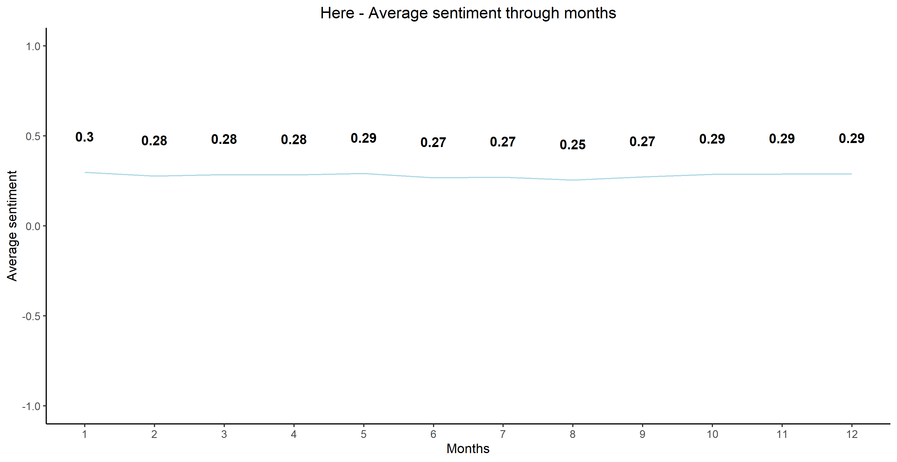
Sentiment Analysis – Larger Apps (Seasonal)
Notes:
Sentiment is stable throughout the year for all 4 apps.

Slide 21
Subjectivity Mean & SD by Year– Smaller Apps
Genius Maps
TomTom
CoPilot
Navmii
Notes:
Subjectivity is a measure which calculates the extent personal views or believes are expressed in the sample text. It also ranges from 0 (objective) to +1 (subjective).
All four apps have reather subjetive reviews (arround 0.5) which is to be expected.
As expected, there aren’t big differences on subjectivity measure.

Slide 22
Subjectivity Mean & SD by Year– Larger Apps
Sygic
Maps.me
Waze
Here
Notes:
Simillar to the smaller apps, bigger apps also have reather subjective reviews with no big difference between them.
It’s interesting there is no significan difference between smaller and bigger apps – thus we can conclude that users of all application use similalr style while leaving comments.
Users are moderately subjective.

Slide 23
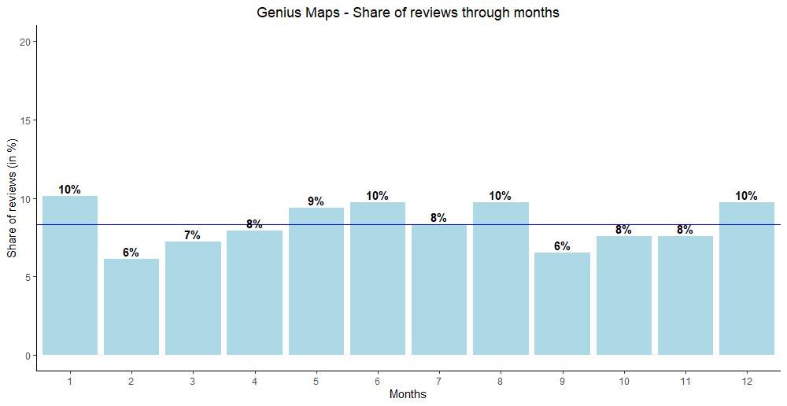
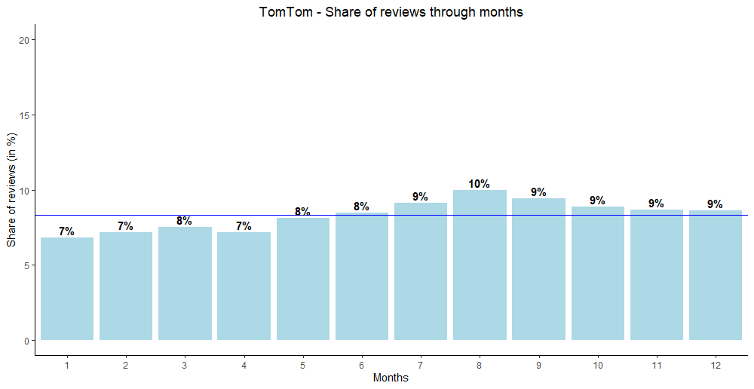
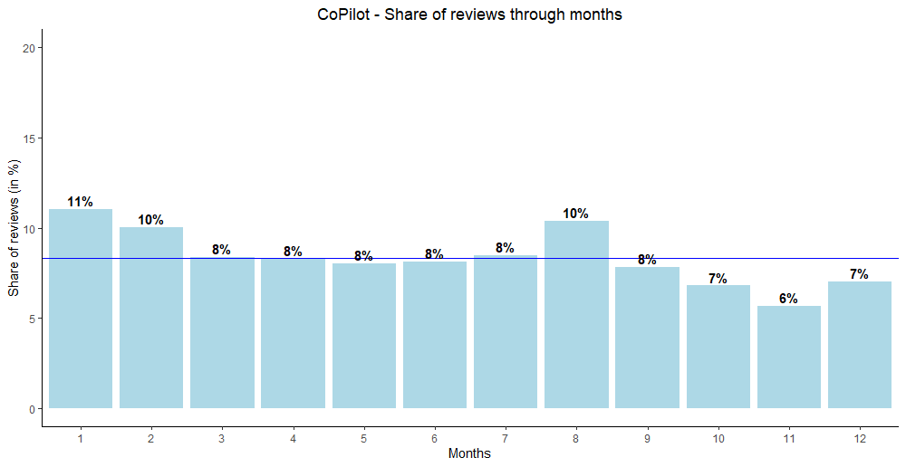
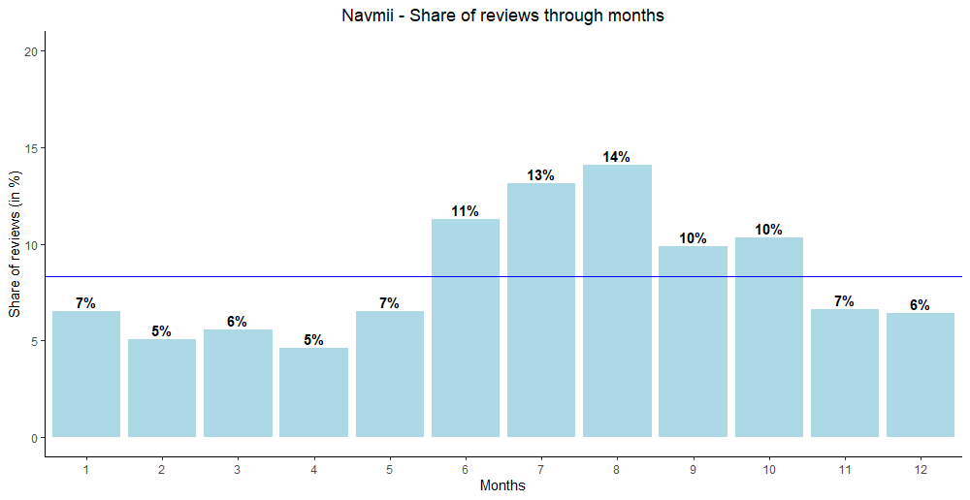
Review Frequency – Smaller Apps (Seasonal)
Notes:
When analysing yearly seasonalities on review frequency, we can conclude that Genius Maps, TomTom and CoPilot get simillar number of reviews each month of the year, while Navmii gets more reviews in the Summer and early Autumn (June to October).

Slide 24
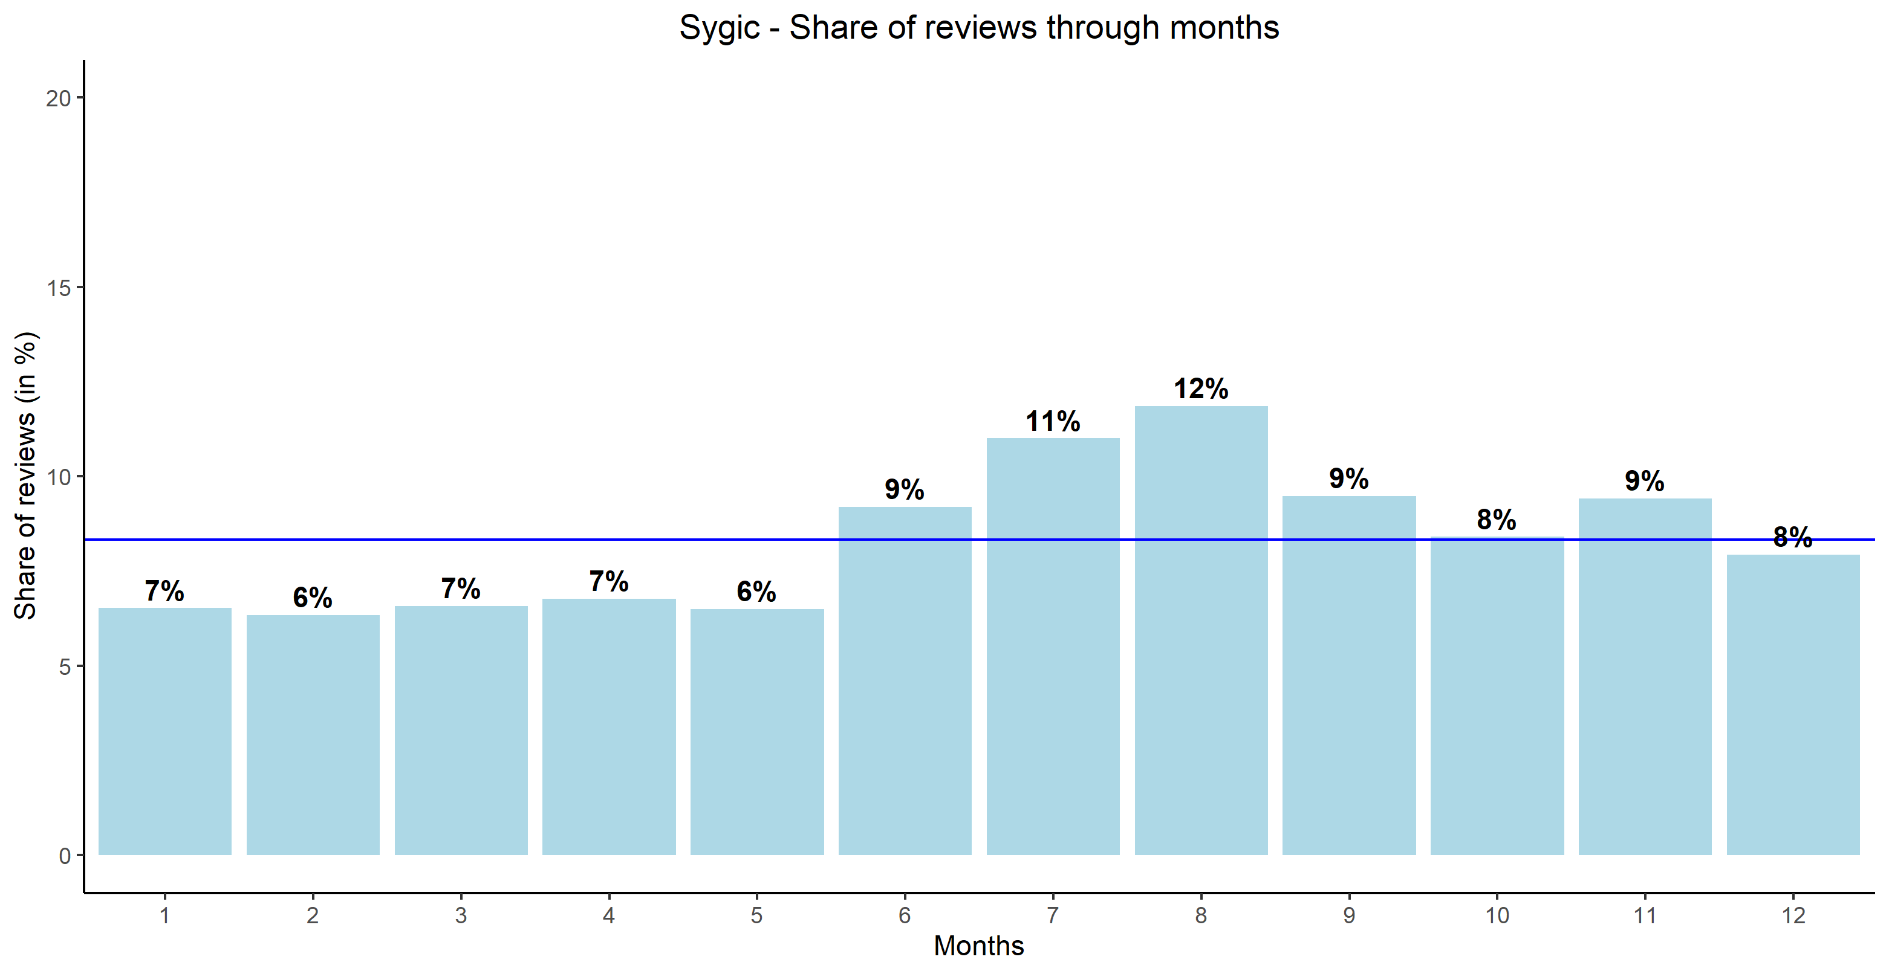
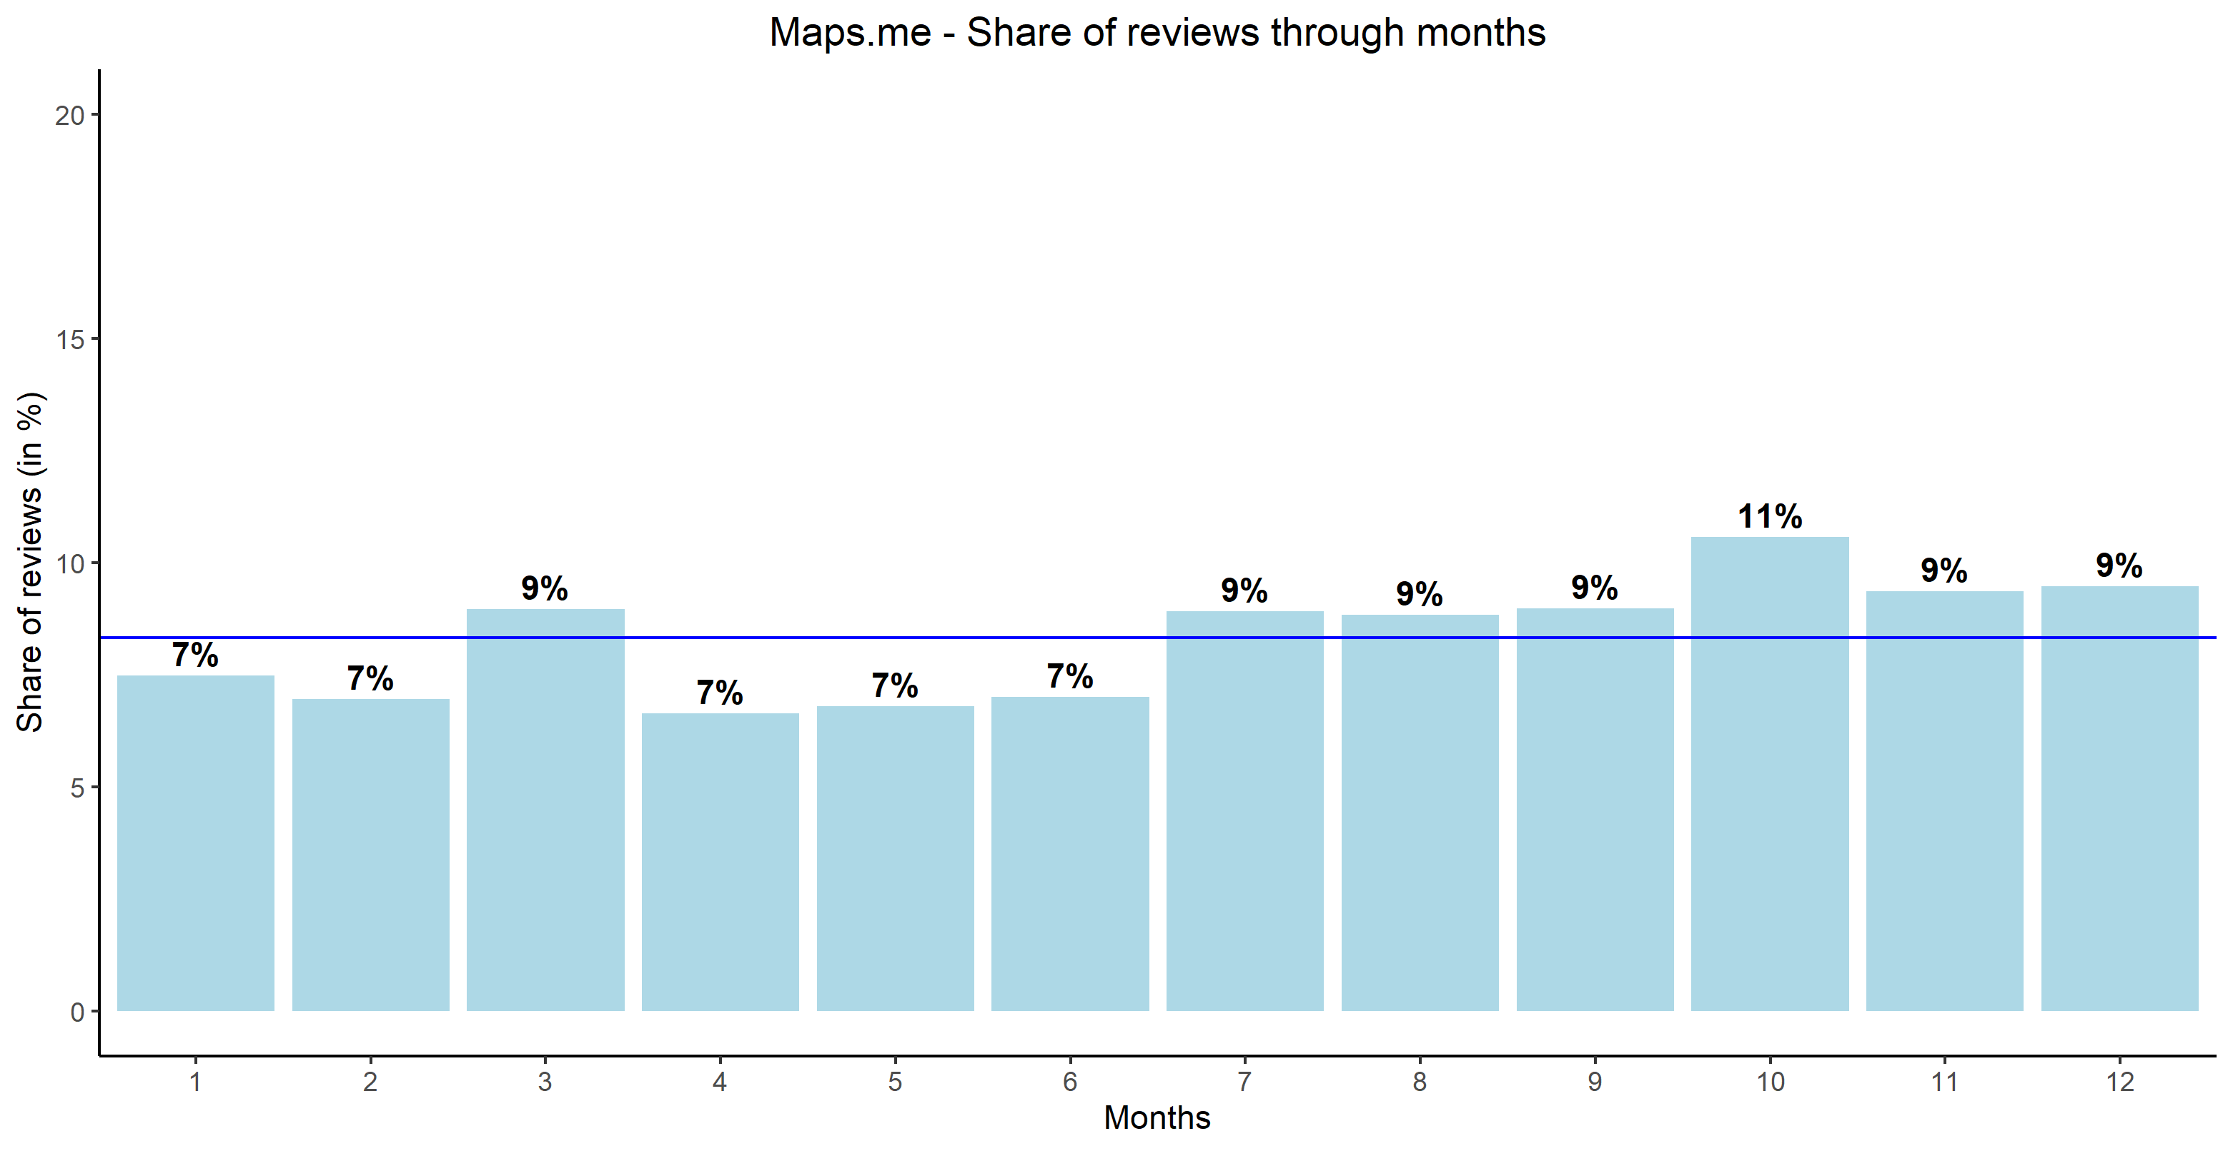
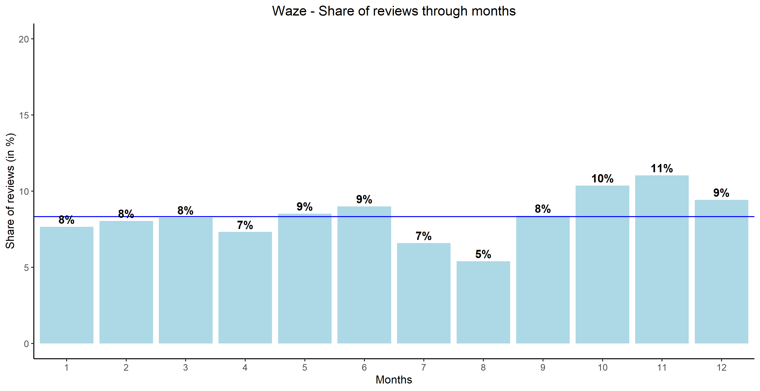
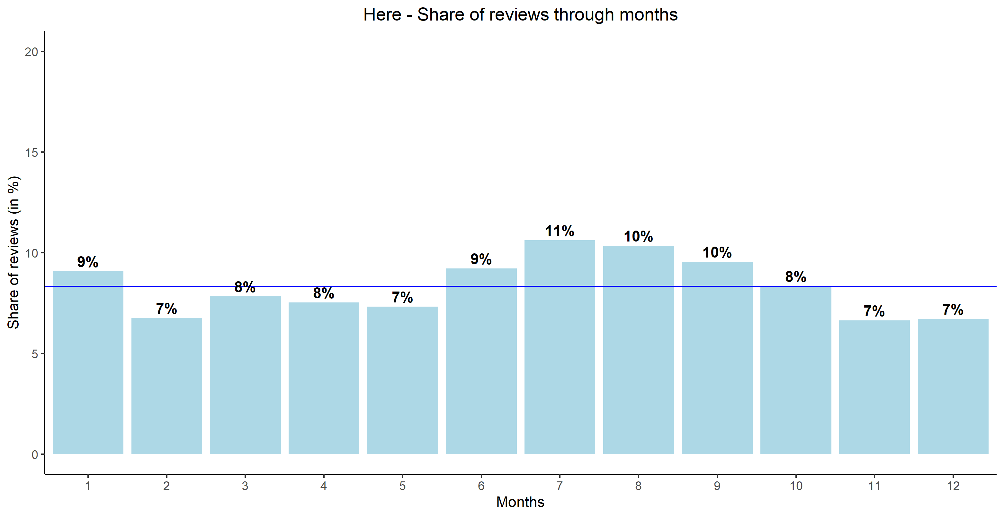
Review Frequency – Larger Apps (Seasonal)
Notes:
Simillarly to smaller apps, Maps.me also gets simillar number of reviews through out the year. Sygic gets more reviews in the Summer with August as its peak. On the other hand, Waze gets more reviews in late Autumn, while Here gets slightly more reviws in Summer and early Autumun.
Waze - drop in 7&8 monthe - other increase - reason?

Slide 25
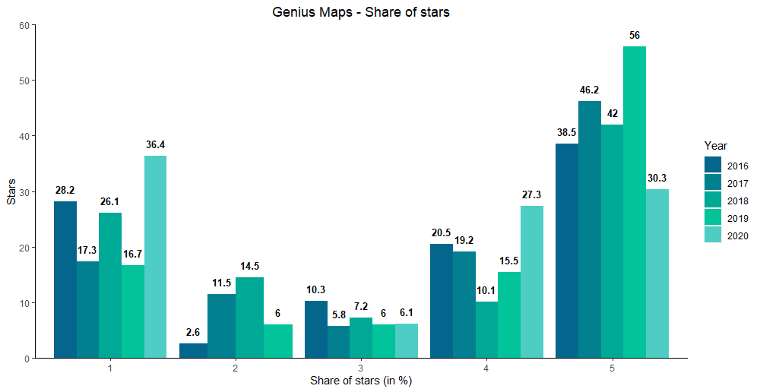
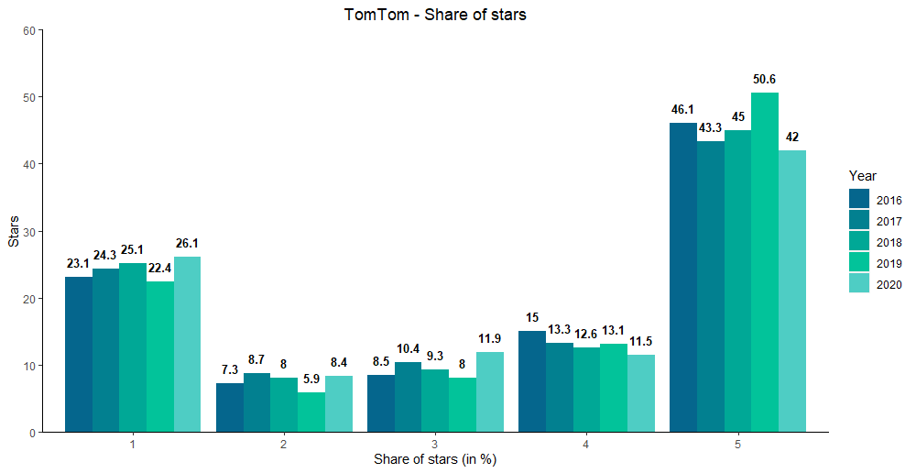
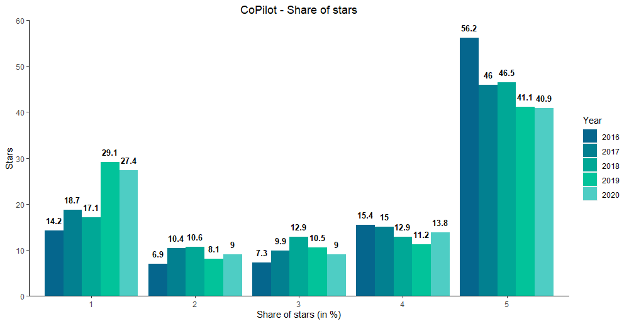
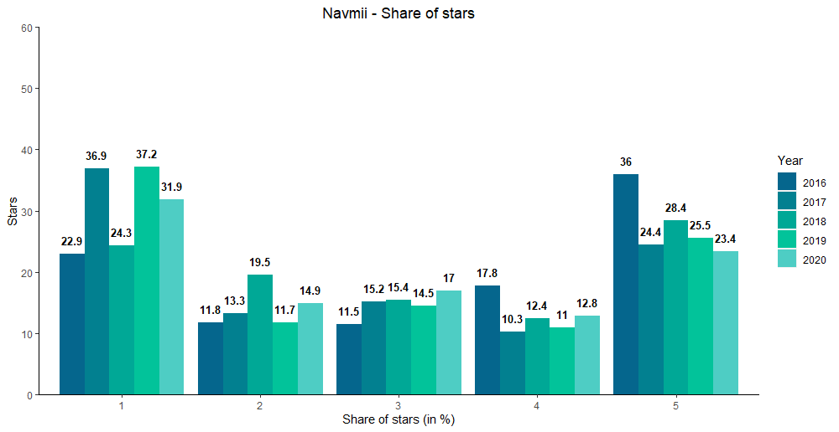
Stars through Years – Smaller Apps
Notes:
Users who leave comment on their review usually give 1 or 5 star evaluation.
Compared to the previous years, in 2020 Genius Maps app has received significantly higher share of 1 and 4 star evaluations, but also significantly smaller share of 2 and 5 star evaluations. **Very small sample size
Trend for other apps remains relatively stable.
Stable

Slide 26
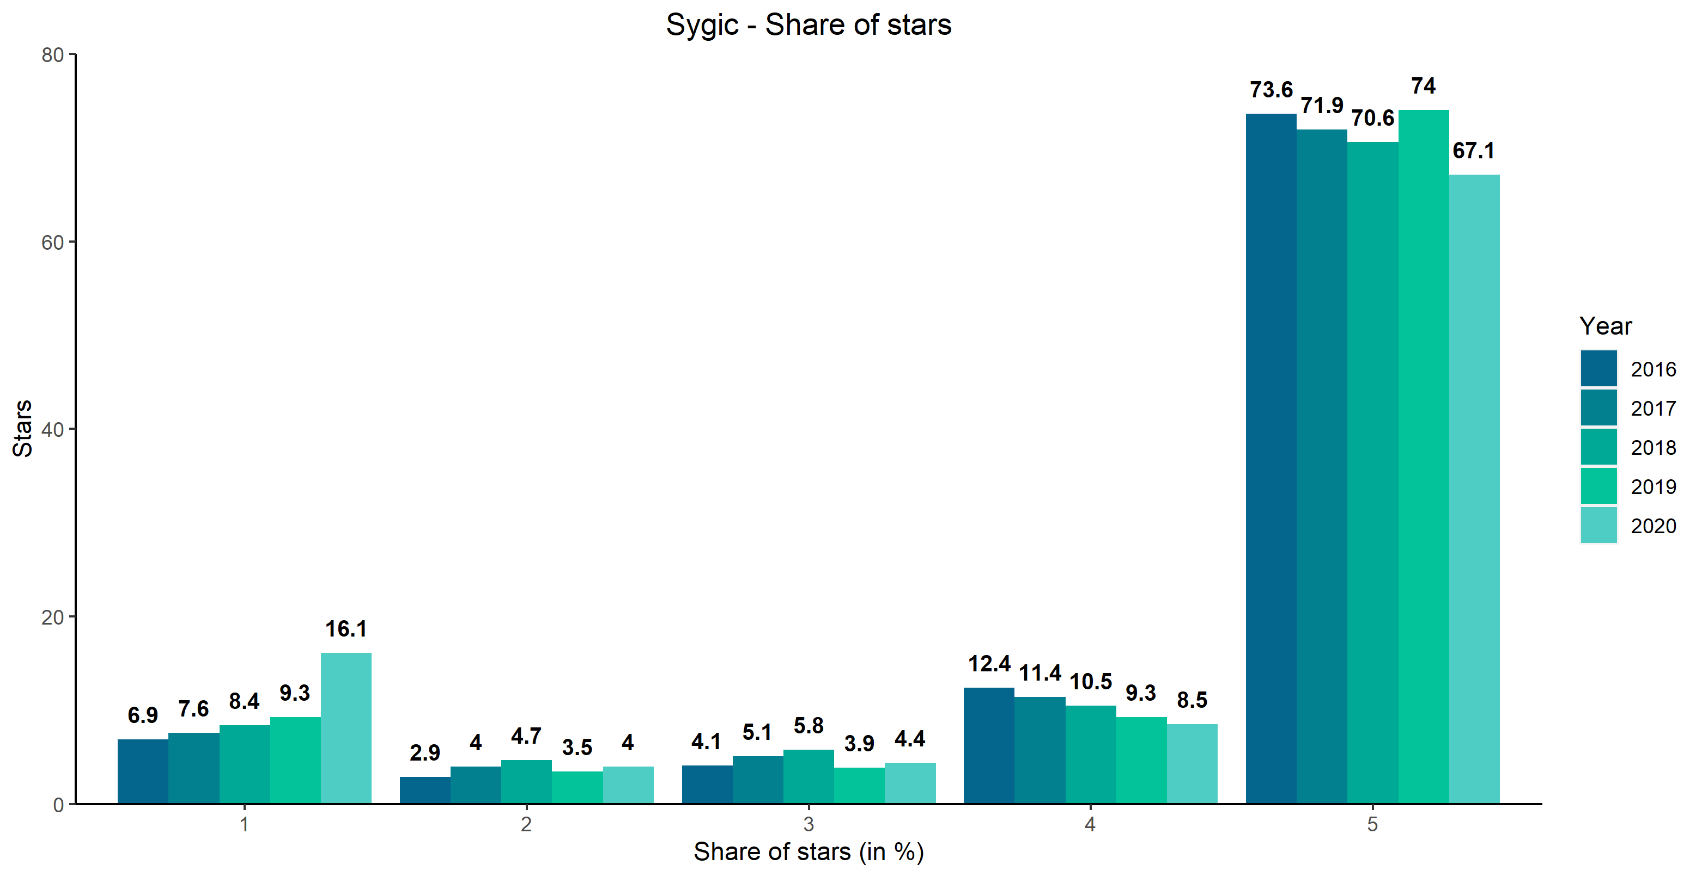
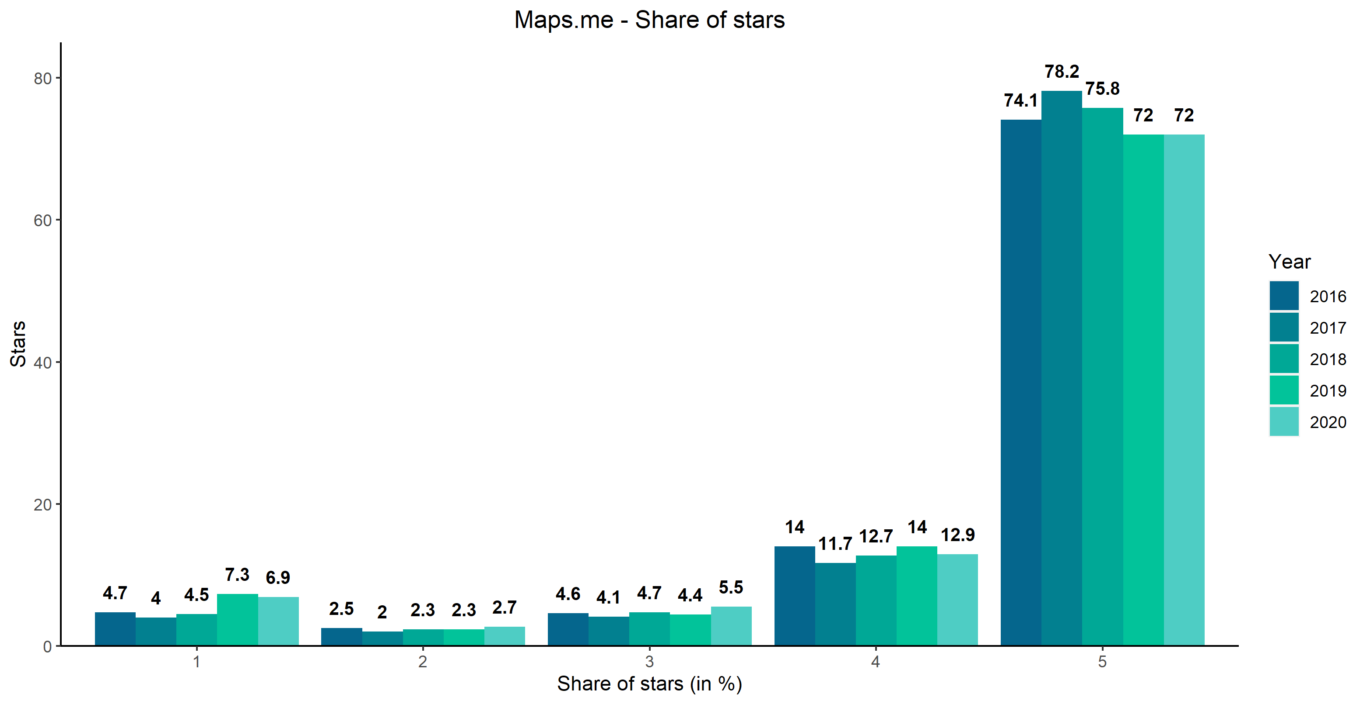
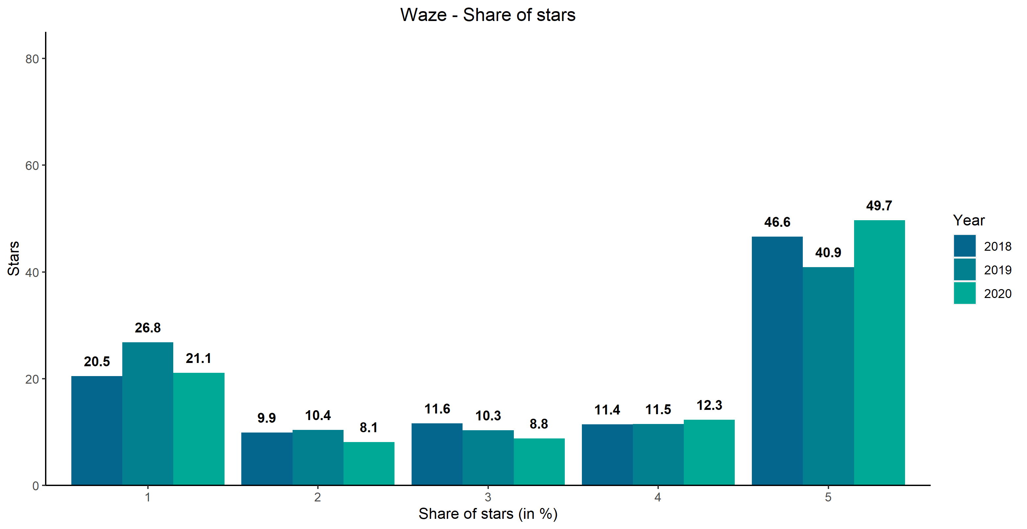
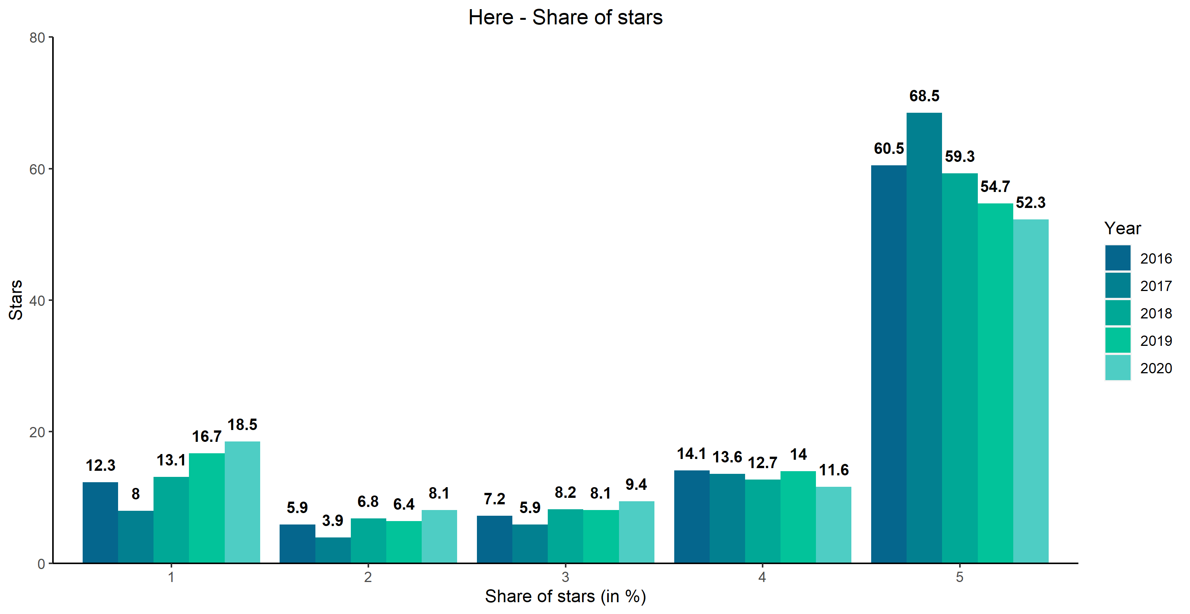
Stars through Years – Larger Apps
Notes:
Compared to smaller apps, bigger apps receive significantly higher share of 5 star evaluations and smaller share of 1 star evaluations.
Trend for all 4 apps remain stable for the past 4 years.
More or less similar.

Slide 27
Lower Star Rating – Smaller Apps
Average number of daily reviews: 0,2
Average number of daily reviews: 5,7
Average number of daily reviews: 2,8
Average number of daily reviews: 0,71
Notes:
*Emphasise difference between this and the next 2 slides
*Explain based on criteria – star sort first, count number second

Slide 28
Lower Star Rating – Larger Apps
Average number of daily reviews: 24,7
Average number of daily reviews: 22,2
Average number of daily reviews: 47,3
Average number of daily reviews: 14,8

Slide 29
Lower Star Rating on Above Average Review Frequency Day – Smaller Apps
Average number of daily reviews: 0,2
Average number of daily reviews: 5,7
Average number of daily reviews: 2,8
Average number of daily reviews: 0,71
Notes:
Days with potential bugs.
This is app specific slide which shows days with above average number of reviews and significantly lower average rating.
Data for Genious Maps is not very interpretable because of the lower average daily number of reviews (less than 1).

Slide 30
Lower Star Rating on Above Average Review Frequency Day – Larger Apps
Average number of daily reviews: 24,7
Average number of daily reviews: 22,2
Average number of daily reviews: 47,3
Average number of daily reviews: 14,8
Notes:
This is app specific slide which shows days with above average number of reviews and decresengly sorted by average rating on that day. Sygic and Here don’t have days with above average number of reviews and a average rating below 3.0

Slide 31
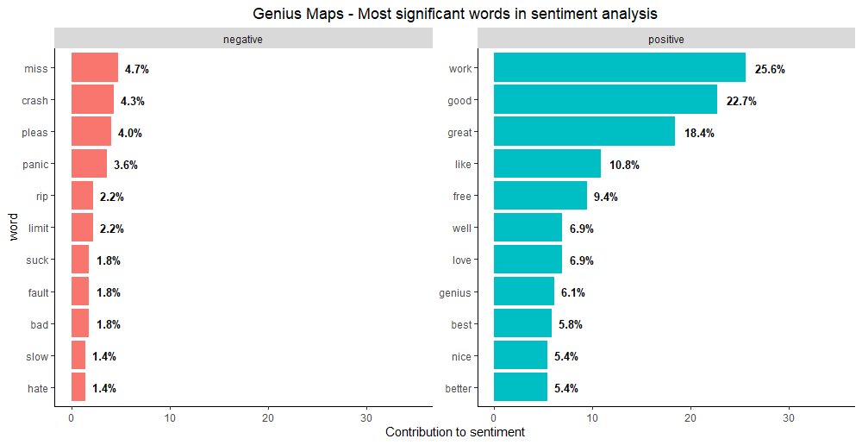
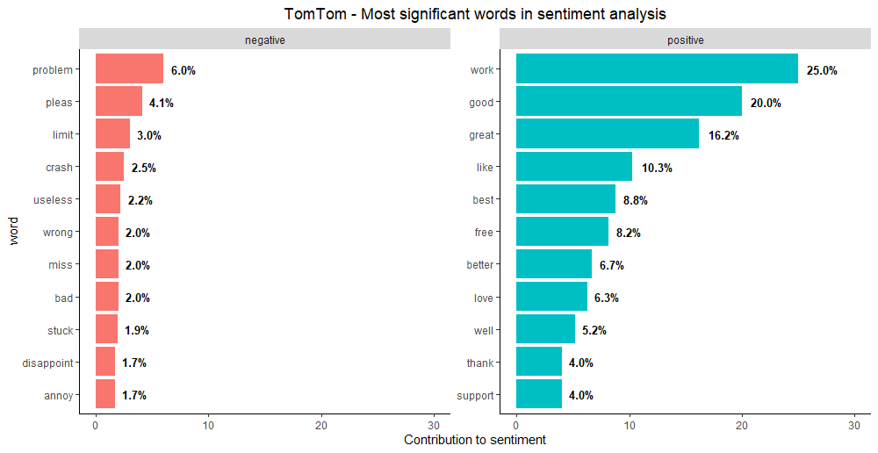
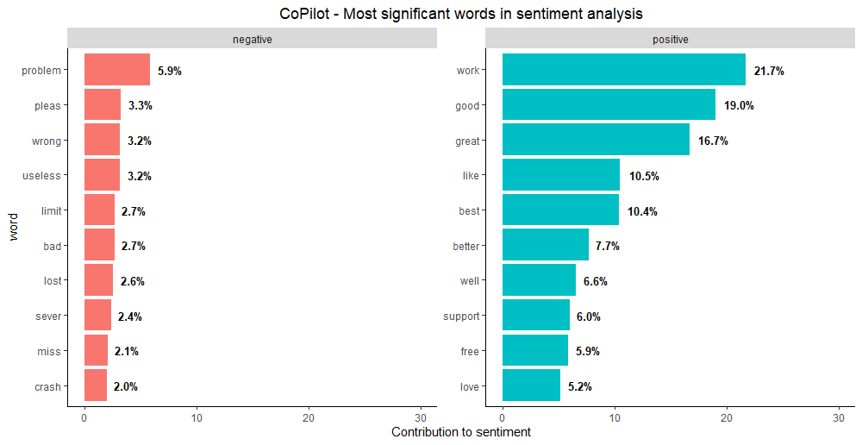
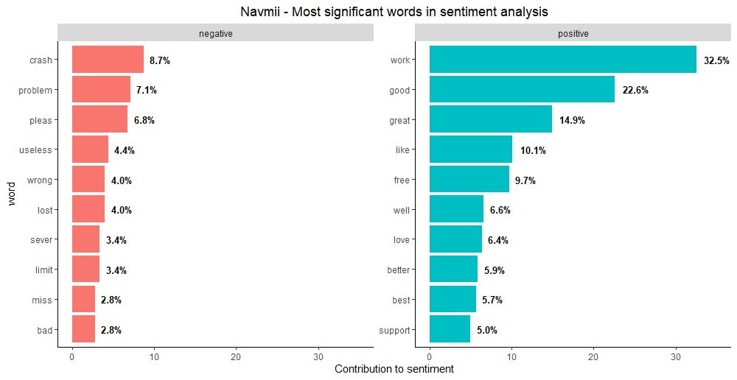
Word Frequency by Sentiment – Smaller Apps
Notes:
When analysing frequency of specific words with negative or positive sentiment, words like work, good and great are most frequently mentioned words with positive sentiment, while problem, crash and useless are more frequently mentioned words with negative sentiment.
Similar to previous slide

Slide 32
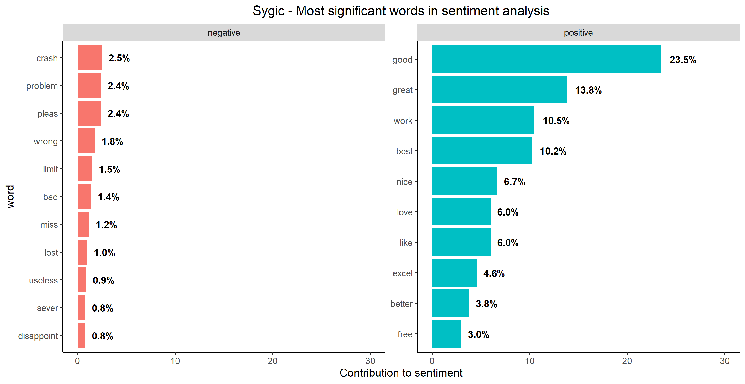
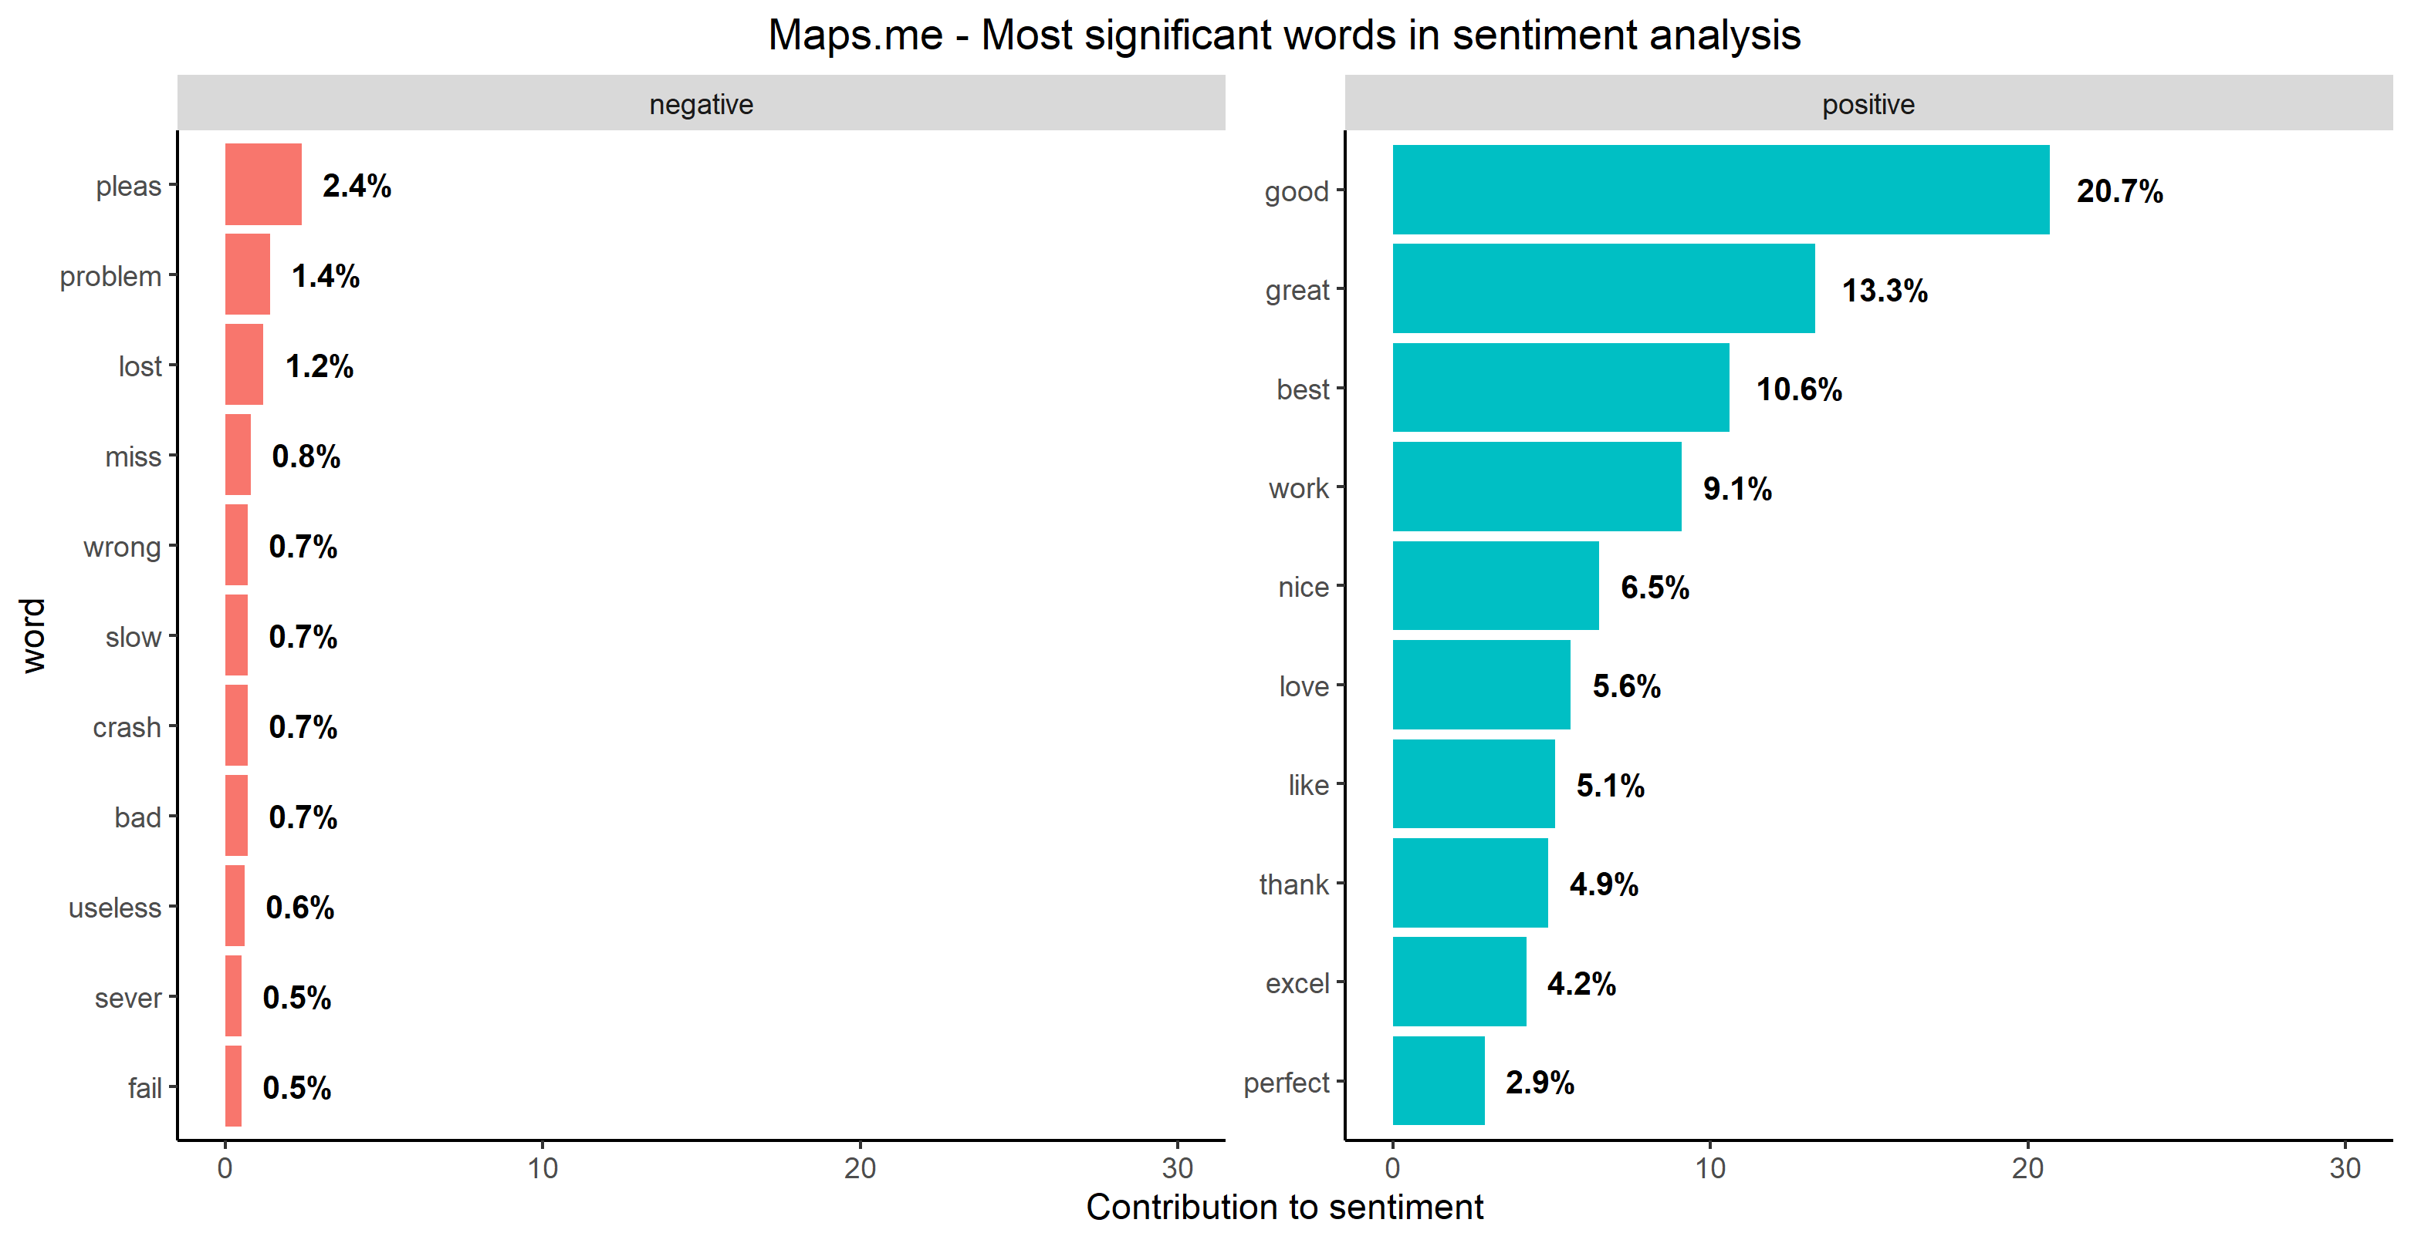


Word Frequency by Sentiment – Larger Apps
Notes:
Simillar conclusion can be drown with data on bigger apps.
Same among all analyzed apps - no big difference - people complain around same things and people tend to give positive comments on same things ☺
With some causion implied, these words can be used in marketing advertising
**All words are analaysed individualy, thoug bigrams like „not working” are included in the sentiment analysis

Slide 33
Bigrams – Smaller Apps
Notes:
This chart shows most frequently used words which are used one next to each other (bigrams).
When analysed together, good/great app, google maps, satelite navigation are bigrams which are frequent in all 4 apps.
BRP - …As we understood…
Google maps - something all small navigations are figthing with

Slide 34
Bigrams – Larger Apps
Notes:
Google maps - all large navigations are figthing with it

Slide 35




Thumbs & Stars – Smaller Apps
Genius Maps
TomTom
CoPilot
Navmii

Slide 36




Thumbs & Stars – Larger Apps
Sygic
Maps.me
Waze (3)
Here

Slide 37




BSTS Review Frequency Prediction Model – Smaller Apps
Notes:
Exponential smoothing (Simple, Holt’s Mehod, Hol’s Seasonal method)
ARIMA
BSTS (SemilocalLinearTrend)
RMSE + MAPE

Slide 38




BSTS Review Frequency Prediction Model – Larger Apps

Slide 39
Things for Further Research
Waze - drop in share of reviews in 7&8 month - other increase - reason?
Sentiment analysis on bigrams
Machine learning algorithm for prediction of thumbs per comment
Include other applications in analysis (eg. iGO Navigation)
Include comments on other languages that are not written in English for sure (translate via Microsoft Azure or Google translate)
Include customer supports replies in the analysis (114799 comments were unreplied)

Slide 40
Sum up 1
People who leave reviews with comments tend to give more negative reviews compared to those who only give a review without the comment
Smaller apps have worse average rating compared to bigger apps.
Navmii and CoPilot (among smaller apps) and Here (among bigger apps) have especially negative rating trend. To add on it, those apps are also receiving less and less new comments

Slide 41
Sum up 2
Generally, in all analyzed apps, people tend to complain and compliment on the same things
Google maps is frequently mentioned bigram in reviews of all apps
Average sentiment is generally positive among all apps (although bigger apps tend to have more positive average sentiment compared to smaller apps, except Waze)
As expected, comments are moderately subjective

